Slide 1
Educating Towards a More Equitable Future
Marina Gorbis
Executive Director

Slide 2
Skills gap?
Source: National Center for Education Statistics
Notes:
Data source: https://nces.ed.gov/programs/digest/d17/tables/dt17_104.10.asp

Slide 3
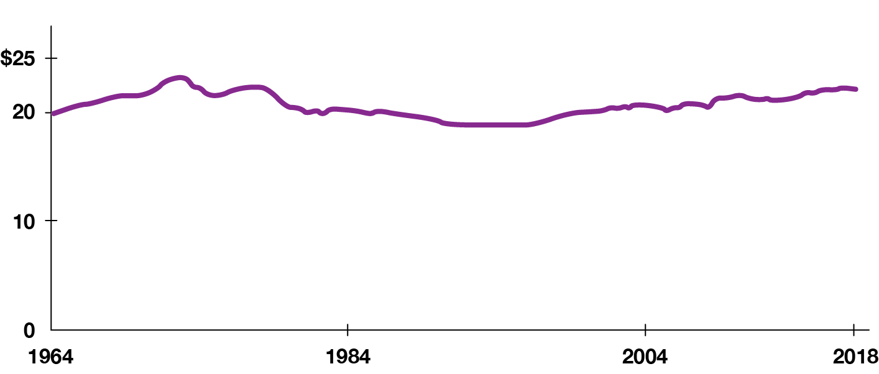
A more educated population has not translated into overall higher wages
Average hourly wages in the U.S., seasonally adjusted
Source: https://www.pewresearch.org/fact-tank/2018/08/07/for-most-us-workers-real-wages-have-barely-budged-for-decades/

Slide 4
A good jobs gap
Source: Economic Policy Institute
Notes:
Good jobs defined as:
Wage >= to the median wage of male workers in 1979
Employer provides some health benefits
Employer provides some retirement/pension benefits

Slide 5
1/5 of low-wage workers in CA have a college degree
Source: American Community Survey 2017

Slide 6
Shortage of STEM graduates?
Life Sciences*
183k
12k
Engineering
169k
51k
Physical Sciences
So Many Degrees, So Little Demand
The number of graduates with technical majors (shown: bachelor, master and Ph.D. degrees awarded in 2015-16) tends to outpace job openings (shown: 2014-24 projections, annualized). Computer science is the exception.
43k
9k
Mathematical Sciences
33k
7k
Computer Sciences
107k
108k
Source: The New York Times; Bureau of Labor Statistics, National Center for Education Statistics

Slide 7
America’s ten largest corporations are low-wage employers
Company | Revenue | Employees | Market Cap. | Compensation
WALMART, INC. | $559,151,000 | 2,300,000 | $397.486 B | $20,942
AMAZON.COM, INC. | $386,064,000 | 1,298,000 | $1.634,168 T | $29,007
UNITED PARCEL SERVICE, INC. | $84,628,000 | 543,000 | $120.442 B | $44,254
HOME DEPOT, INC. | $132,110,000 | 504,800 | $291. 565 B | $27,389
KROGER CO. | $132, 498,000 | 465,000 | $26.266 B | $24,617
TARGET CORP. | $93,561,000 | 409,000 | $90.725 B | $24,535
INTL. BUSINESS MACHINES | $73,620,000 | 375,300 | $112.166 B | $49,001
BERKSHIRE HATHAWAY, INC. | $65,841,000 | 360,000 | $317.883 B | $68,543
STARBUCKS CORP. | $23,518,000 | 349,000 | $100.440 B | $12,113
LOWE’S COMPANIES, INC. | $89,597,000 | 340,000 | $122.255 B | $24,554
Source: Taming Corporate Power in the 21st Century, Gerald F. Davis, University of Michigan, forthcoming book
Notes:
From Jerry Davis AARP presentation

Slide 8
America’s wealthiest companies are not large employers
Company | Revenues | Employees | Market Cap | Compensation
APPLE, INC. | $274,515,000 | 147,000 | $2.007,837 T | $57,783
AMAZON.COM, INC. | $386,064,000 | 1,298,000 | $1.634,168 T | $29,007
MICROSOFT CORP. | $143,015,000 | 163,000 | $1.543,306 T | $172,142
TESLA, INC. | $31,536,000 | 70,757 | $668.905 B | $58,455
FACEBOOK, INC. | $85,965,000 | 58,604 | $656.668 B | $262,633
ALPHABET, INC. | $182,527,000 | 135,301 | $526.920 B | $273,493
JOHNSON & JOHNSON | $82,584,000 | 134,500 | $414.310 B | $81,000
WALMART, INC. | $559,151,000 | 2,300,000 | $397.486 B | $20,942
JP MPRGAN CHASE & CO. | $119,995,000 | 249,184 | $387.335 B | $80,102
MASTERCARD | $14,980,000 | 21,000 | $352.825 B | $132,114
Source: Taming Corporate Power in the 21st Century, Gerald F. Davis, University of Michigan, forthcoming book

Slide 9
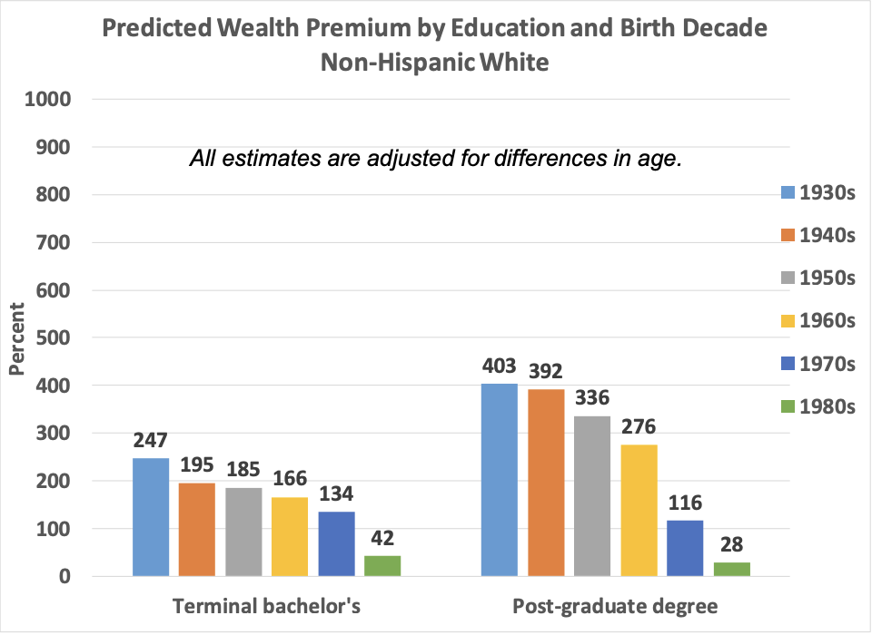
Wealth premiums of college degrees declining
Predicted wealth premium by education and birth decade, non-Hispanic White
Percent
All estimates are adjusted for differences in age.

Slide 10
Wealth premiums of college degrees collapsing for African Americans
Predicted wealth premium by education and birth decade, non-Hispanic Black
Percent
All estimates are adjusted for differences in age.

Slide 11
Racial wealth inequalities persist across educational levels
Notes:
Chart comparing people with college and without college and comparing incomes?
In the long version before Charles edited?

Slide 12
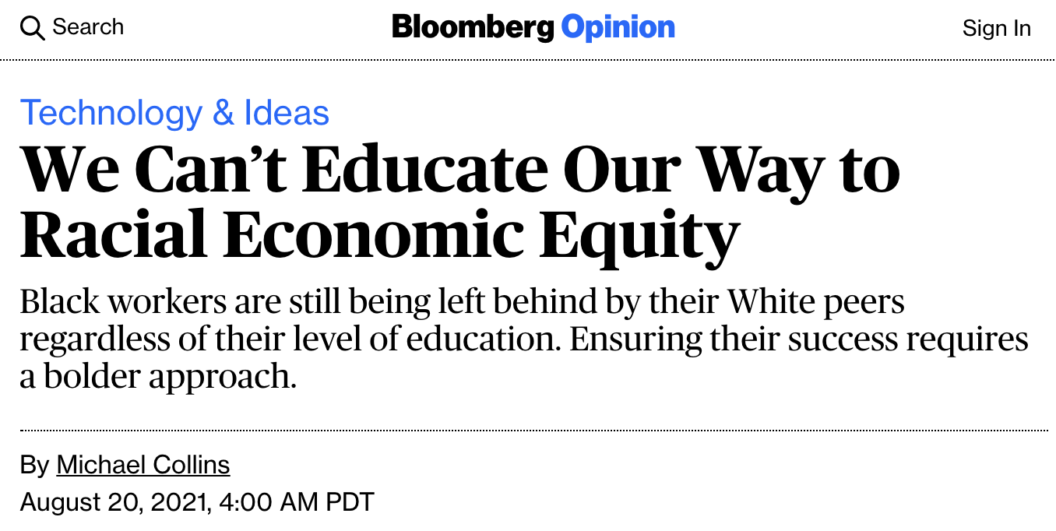
Education alone is not a solution
Notes:
Sources: https://www.bloomberg.com/opinion/articles/2021-08-20/racial-economic-equity-won-t-happen-with-education-alone?utm_source=twitter&utm_campaign=socialflow-organic&utm_medium=social&utm_content=view&cmpid%3D=socialflow-twitter-view
https://www.wsj.com/articles/some-ceos-suggest-dropping-degree-requirements-in-hiring-11620233566?reflink=desktopwebshare_twitter

Slide 13
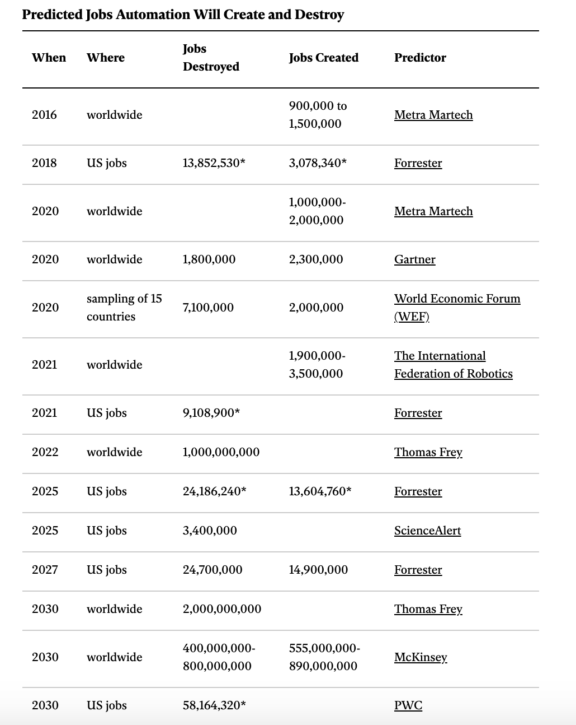
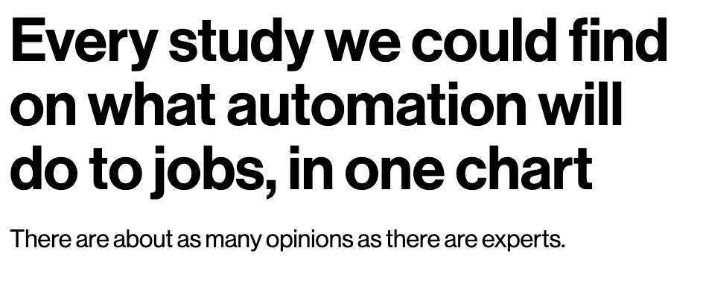
Let’s talk about automation

Slide 14
Technology can change work in many ways
Amount of work (i.e. creating and eliminating jobs)
Content of work (including the skills involved)
Conditions of work
Wages/earnings
How work is controlled and who controls it
Distribution of work (e.g. by race, gender, geography)

Slide 15
Affordances of today’s technologies
Codify human work processes, particularly in services
Break up work into smaller bits (tasks)
Recruit large networks to complete tasks
Efficiently route tasks

Slide 16
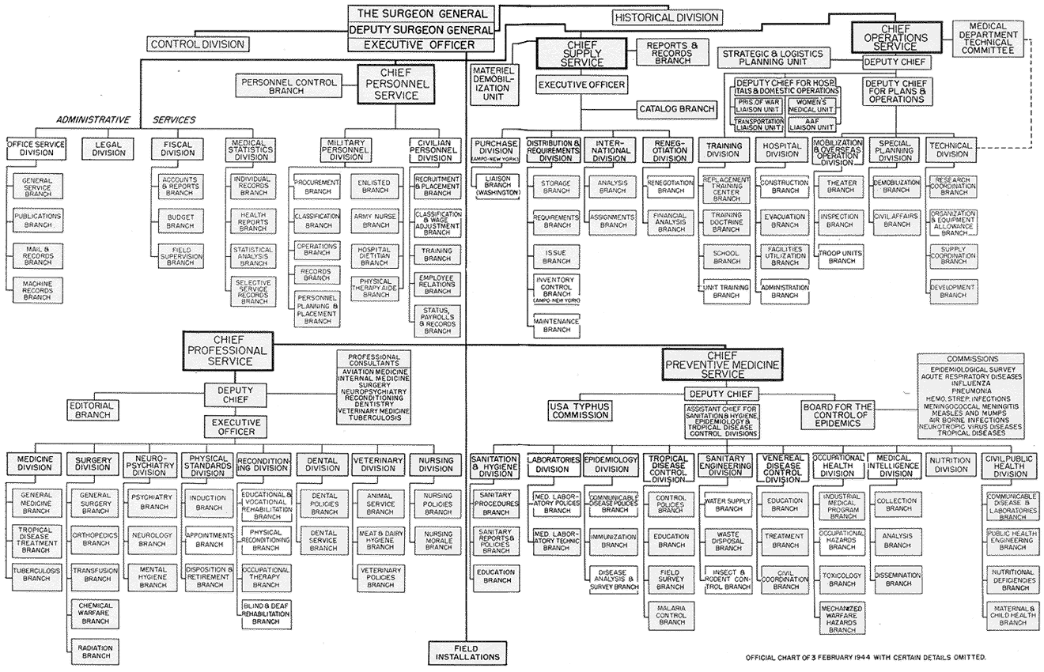
16

Slide 17
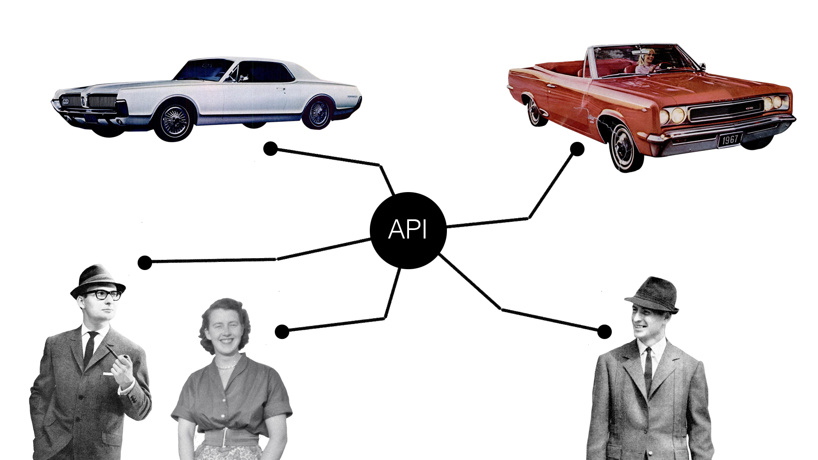

Slide 18
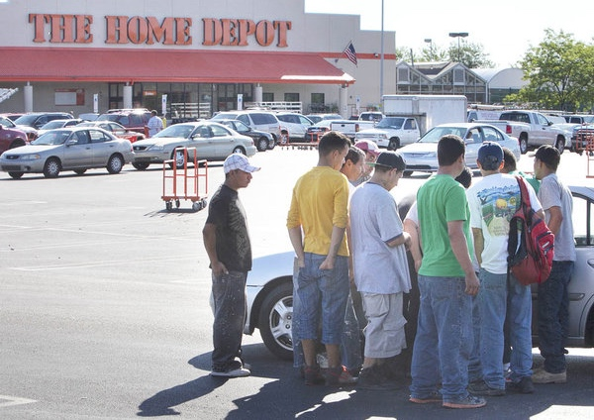
Spot market for labor

Slide 19
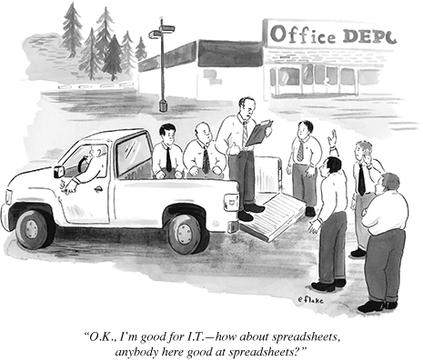
Spot market for labor

Slide 20
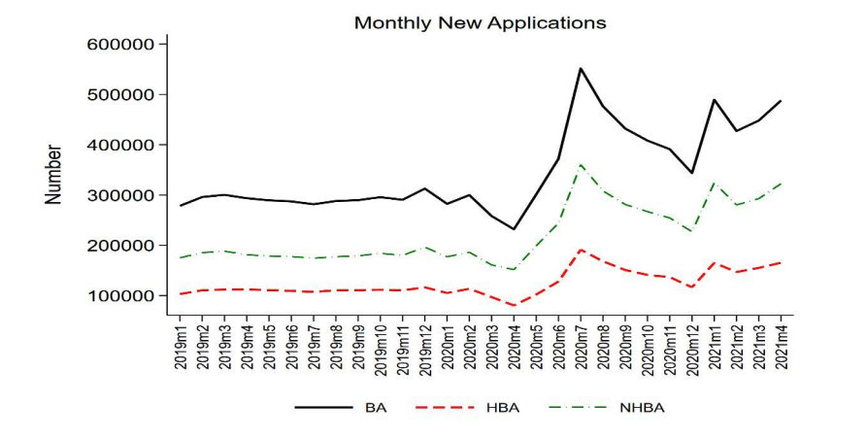
Boom in small business?
Notes:
Notes: Source: BFS. BA=All business applications. HBA=High Propensity Applications (likely employers). NHBA=BA-HBA (likely nonemployers)

Slide 21
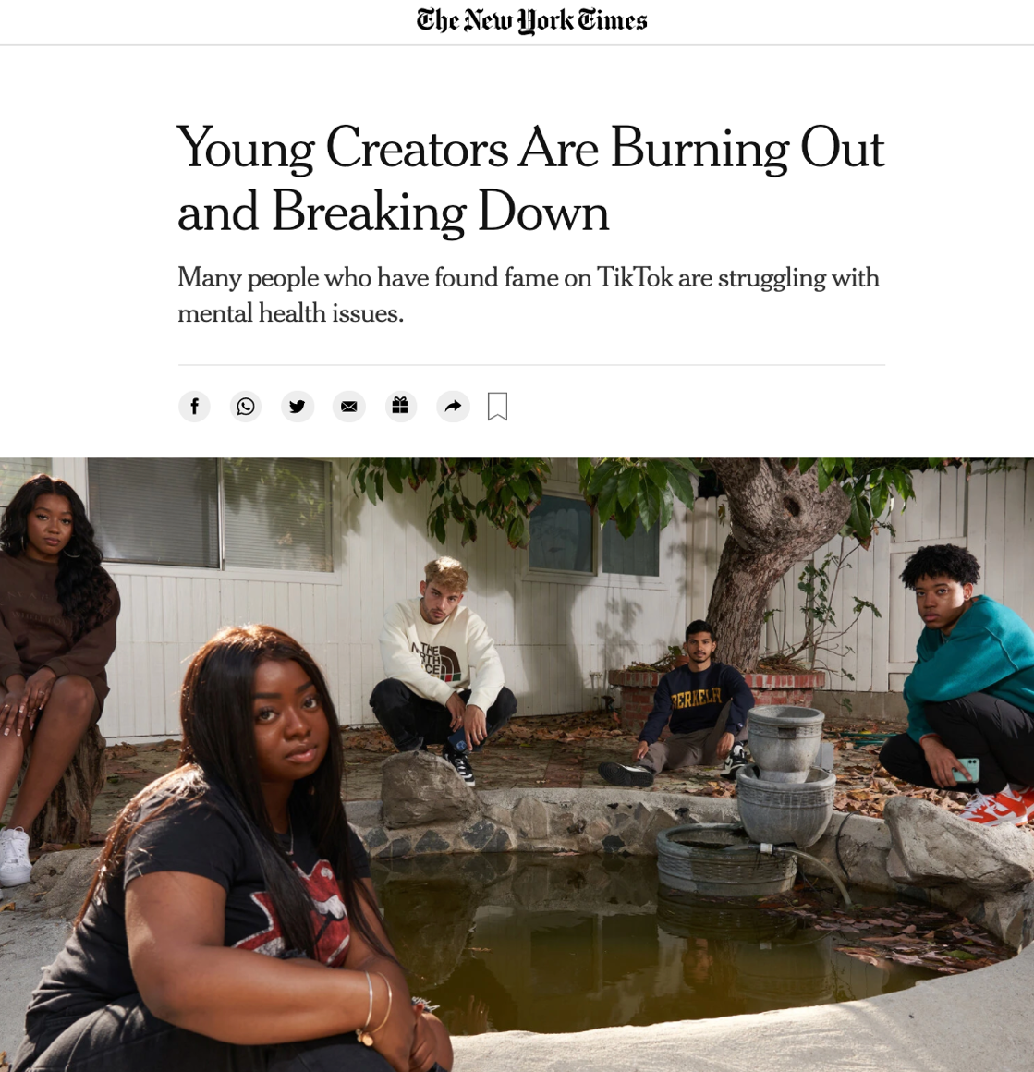
Influencers: #1 desired occupation for the new generation
Notes:
Looks glamourous from the other side of the screen …
“But problems with burnout in the creator community are endemic.
Per YouTuber Olga Kay “If you slow down, you might disappear,”
YouTuber Olga Kay
Photo: Michelle Groskopf for the NYTimes
NYT quote: https://www.nytimes.com/2021/06/08/style/creator-burnout-social-media.html?smid=tw-share
Potential quote:
Olga Kay (born Olga Karavaeva;^{[1]} Russian: Ольга Сергеевна Караваева; November 20, 1982) is a Russian-American Internet celebrity (mainly known as a YouTube personality), performer and entrepreneur.^{[2]} Trained as a professional circus juggler in her youth, she later moved to acting and video creation. In 2006 she started the YouTube channel OlgaKay, creating shows such as Emo Girl and Olga Kay's Show. Adding channels on gaming and fashion, by 2013 her four combined channels had approximately a million subscribers.

Slide 22
By choice, or by necessity, people are refashioning their relationship to work
Notes:
After decades of stagnating wages and deteriorating quality jobs, compounded by Covid’s global and continuing devastating toll on low wage workers; work is not working for people.
Jobs are no longer providing providing economic security and people are completely re-evaluating and refashioning when, where and—most importantly how they work.

Slide 23
The rise of non-institutional work

Slide 24
The way we work is a product of multiple factors
Social and cultural norms
Available technologies and scientific knowledge
Regulatory regimes
Power dynamics
Labor availability
Social safety net

Slide 26
Equitable Enterprise is an ecosystem of business, financial, health, education, and community structures and strategies that equitably distribute assets among those who contribute value to the system.
Notes:
After decades of stagnating wages and deteriorating quality jobs, compounded by Covid’s global and continuing devastating toll on low wage workers; work is not working for people.
Jobs are no longer providing providing economic security and people are completely re-evaluating and refashioning when, where and—most importantly how they work.

Slide 27
TECHNOLOGY, WORK, & EDUCATION
Cooperatives
Employee stock owned companies
Community trusts
Limited profit companies
Public and community banks
Purpose trusts
Types of equitable enterprises
Notes:
Types of equitable enterprises:
Cooperatives
Employee stock owned companies
Community trusts
Limited profit companies
Public and community banks
Purpose trusts

Slide 28
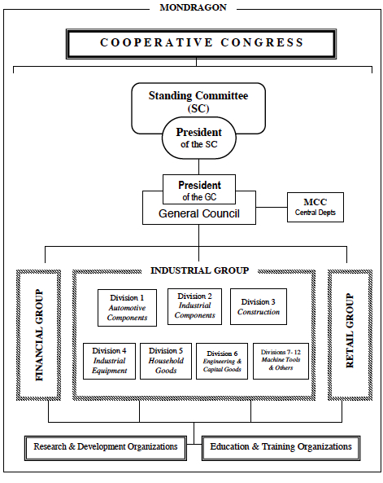
© 2022 Institute for the Future. All rights reserved. SR-2287 | iftf.org
Notes:
https://duckduckgo.com/?q=mondragon+structure&t=newext&atb=v267-1&iax=images&ia=images&iai=http%3A%2F%2Fwww.maussen.eu%2Fwp-content%2Fuploads%2F2015%2F10%2FMondragon-Network-Structure.jpg
https://duckduckgo.com/?q=mondragon+structure&t=newext&atb=v267-1&iax=images&ia=images&iai=https%3A%2F%2Faqus.com%2Fwp-content%2Fuploads%2F2017%2F03%2Fmondragon1.jpg

Slide 29
Community colleges can play a pioneering role in re-shaping traditional business education and training students in creation and paritication in more equitable enterprises
Notes:
After decades of stagnating wages and deteriorating quality jobs, compounded by Covid’s global and continuing devastating toll on low wage workers; work is not working for people.
Jobs are no longer providing providing economic security and people are completely re-evaluating and refashioning when, where and—most importantly how they work.

Slide 30
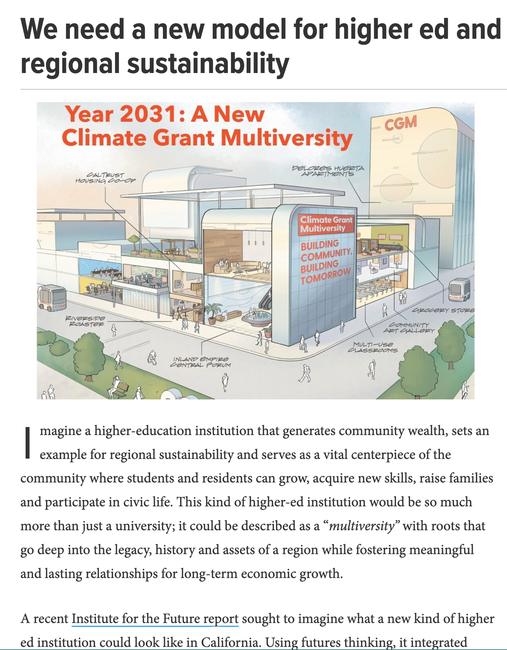
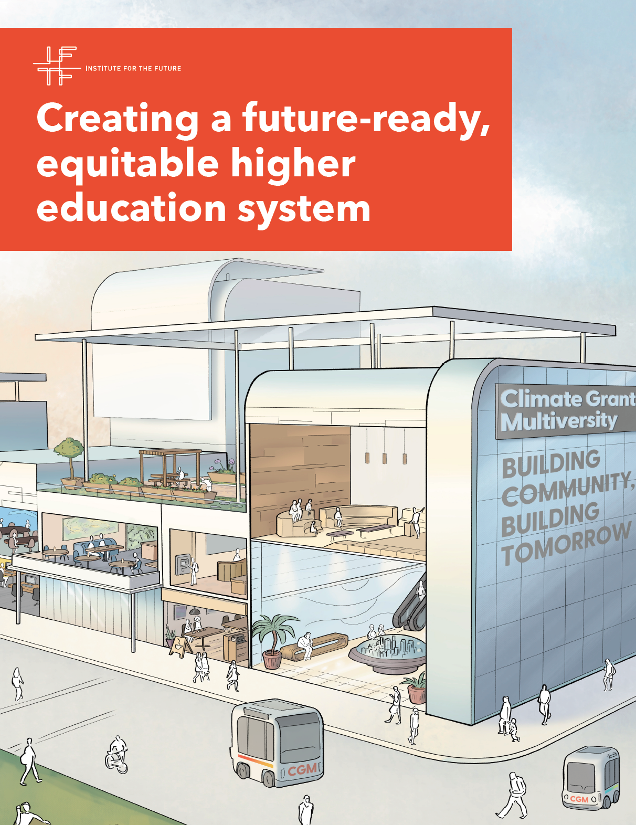
www.iftf.org
Notes:
The New College Student: Perils of One-Size-Fits-All Education
Bureaucracies: Navigating Fragmented Processes Hinders Success
Student Success: Insufficient Guidance and Support
Stigmatization: Inequity, Polarization, Stratification across Segments
Campus Climate: Insecurity and Sense of Belonging
Fragmentation: The “System” Doesn’t Operate as One
Institutional Performance: High Costs, Poor Outcomes

