Slide 1
Organizational Culture for the Multigenerational Workplace
Data - Myths - Action

Slide 2
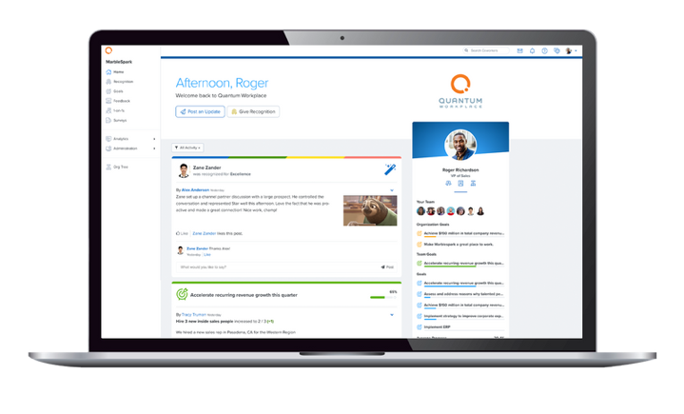
About Quantum Workplace
Dr. Shane McFeely
Lead Researcher
Quantum Workplace
Our employee success software helps organizations improve employee engagement and performance so they can grow and succeed.
Teresa Preister
Senior Insights Analyst
Quantum Workplace
Notes:
Both

Slide 3
Agenda
Unpacking Organizational Culture
Myth-Busting: Generations in the Workplace
Building Culture – a discussion
Q & A
Notes:
Shane

Slide 4
SECTION 1
Unpacking Organizational
Culture
Notes:
Shane

Slide 5
Access the research at
quantumworkplace.com/evanta
Why Organizational Culture is Top of Mind
Rise of remote and hybrid work
The Great Recruitment
Competitive labor market
Culture has gone viral
Notes:
Shane

Slide 6
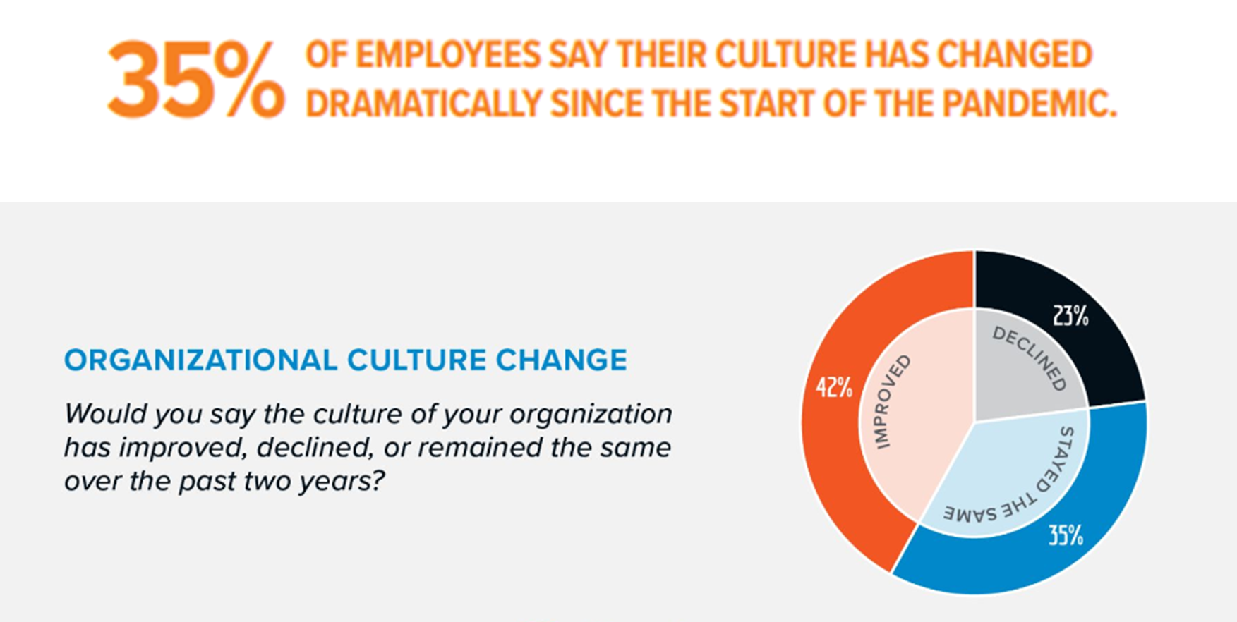
Culture Shift
Notes:
Shane

Slide 7
COMMUNICATE
MAKE
DECISIONS
Defining Organizational Culture
HOW WE DO THINGS
BEHAVE
CELEBRATE
REWARD & RECOGNIZE
Notes:
Teresa

Slide 8
Being intentional with culture
Every organization has a culture
If you are not shaping it, someone or something else is
Your culture is not benefiting your organization if it is not strengthening employee engagement
Notes:
Teresa

Slide 9
In which of the following aspects of your workplace do you experience your organization's culture most strongly?
Top 3 Results
Mission or values statement
Recognition or celebrations
Approach to employee performance
Bottom 3 Results
Rituals or norms
Onboarding or training
23%
42%
Physical workspace
Notes:
Shane

Slide 10
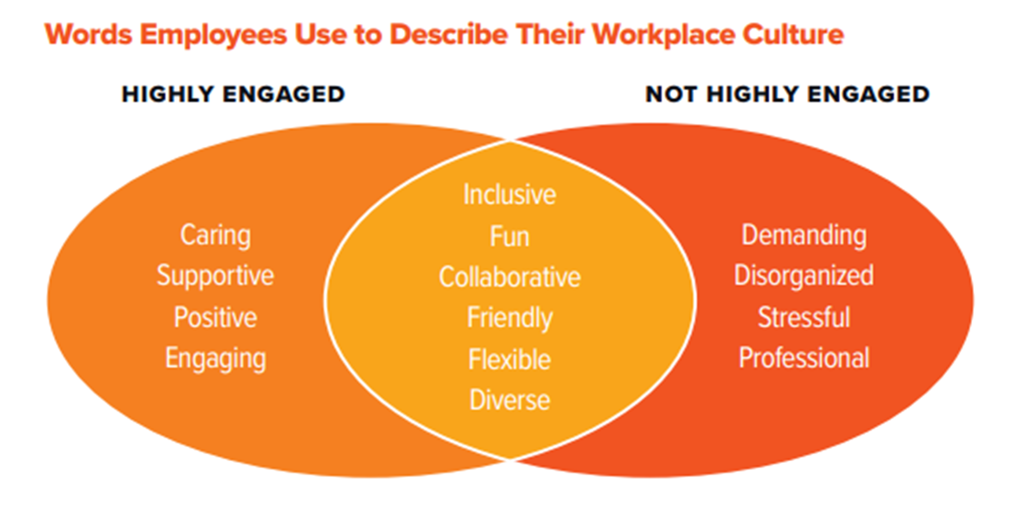
How organizational culture impacts employee engagement?
Notes:
Shane

Slide 11
SECTION 2
Myth Busting: Generations in the Workplace
Notes:
Teresa
Building a culture good for all generations. No evidence that a younger employees looking for a job today is any different than 20 -40 – 60 years ago. Need to get the basics of culture right, and not pander toward certain generations. Too many myths out there about generations. Generations also represent protected workplace classes

Slide 12
Why myth bust?
There is no evidence that younger employees in the workforce are all that different than those 20 or more years ago.
Focusing on generations can steal the focus from creating a culture that is good for all employees
Generations represent protected workplace classes
There are many myths and generalizations about generations, which risks stereotyping
54%
53%
50%
37%
33%
28%
Notes:
Teresa
Indeed, a recent consensus study published by the National Academies of Sciences, Engineering, and Medicine (NASEM) concluded that “Categorizing workers with generational labels like ‘baby boomer’ or ‘millennial’ to define their needs and behaviors is not supported by research, and cannot adequately inform workforce management decisions…” (NASEM, 2020a; see also NASEM, 2020b).

Slide 13
Myth #1
Generational Explanations are Obvious
Generations have been oversimplified
Other time-based factors are more likely explanations for variation
Specific birth year ranges vary substantially
Meta-analytic findings show no differences in job satisfaction, job hopping, workforce participation, or narcissism
Notes:
Shane

Slide 14
Myth #2
Generations Need to be Managed at Work
Leaders should work to create a strong culture for everyone, regardless of age
It is more effective to manage perceptions of generations, rather than generations themselves
Organizations are open to liability by managing individuals based on generation
Notes:
- Shane
Managers should work to create a strong culture for everyone on their team, regardless of age or other factors

Slide 15
Myth #3
Younger Generations are Disrupting Work
Changes in the workplace are more likely due to the uniqueness of the current period in time and the innovations and changes that occur as a result
Blaming members of any generation for the work environment is a form of uniqueness bias
Notes:
Shane
We think our beliefs and experiences are new, when in reality they are similar to issues attributed to relatively younger or older generations for millennia. Ex: “out of touch” older generations and lazy and self-centered or entitled younger generations.
“One of the more obvious examples is in referring to generations with self-referent terminology: New York Magazine wrote about youth in the so-called “Me” Decade (Wolfe, 1976) over 30 years prior to Twenge’s (2006) work on “Generation Me,” Time Magazine’s (Stein, 2013) publication on the “Me Me Me” generation, and even the British Army’s recent use of the phrase “Me Me Me Millennials…Your Army needs you and your self belief” in recruitment ads (Nicholls, 2019)”
Moreover, similar concerns have been voiced throughout the years regarding the rise and fall of consumer preferences, including concerns about young people upending and revolutionizing romantic relationships and transportation (e.g., Thompson, 2016), or being corrupted by new forms of popular media like the radio in the 1930s (Schwartz, 2015).
Generations give a convenient "wrapper" to the complexities of age and aging in dynamic environments. Rather than blaming those of younger generations for disrupting work and life more generally, societal trends and events are a more appropriate, fitting, and ultimately addressable explanation (i.e., through non-ageist interventions and policies).

Slide 16
Myth #4
Talking about Generations is harmless
Legal risks - promotes agism
Increases gap and closes off the conversation
Risk to inclusivity
Notes:
Shane
Move away from managing assumed preferences based upon any demographic

Slide 17
Workplace Management for All
How can we create a culture that everyone can thrive in?
Notes:
Shane
There are , and have been many generations in the workplace, what has changed that has impacted workplace, How do we create a culture that everyone can thrive in, retain, identify HiPos at all ages. GenZ 1997 – 2012 – ridiculous to paint everyone in a gen w/ the same portrait – 26 y/o to 11 y/o

Slide 18
SECTION 3
3 ways to be intentional about your culture
Notes:
Shane

Slide 19
COMMUNICATE
MAKE
DECISIONS
Defining Organizational Culture
HOW WE DO THINGS
BEHAVE
CELEBRATE
REWARD & RECOGNIZE
Notes:
Shane
Speak to the top ways employees experience culture – we discuss the top three ways ees experience culture. Performance Mgmt, Trust in Leadership (mission) (who is resp. for shaping culture… Leaders), recognition

Slide 20
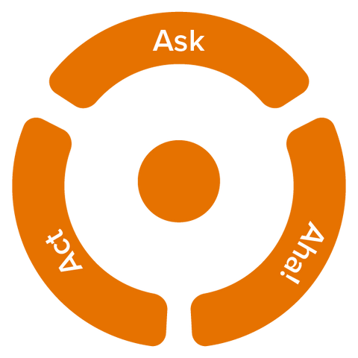
Notes:
Shane

Slide 21
1
Approach to Performance Management
Notes:
Teresa
What's one word you would use to describe your emotional state or reaction to performance management?

Slide 22
What is one word you would use to describe your emotional state or reaction to performance management?
1
Approach to Performance Management
Notes:
Teresa

Slide 23
Performance Management:
Top 5 Drivers of Employee Engagement
Employee recognition
Fair performance evaluation
Effective, ongoing feedback
Goal alignment
Employee empowerment
36% of employees prefer weekly performance conversations with their managers.
1
Approach to Performance Management
Notes:
Teresa

Slide 24
Designing for success
Don’t perpetuate broken performance management practices
Create a culture of effective employee feedback and listening
Empower people leaders to have more continuous conversations
Align individual goals with team and organizational goals
Ensure performance practices are fair and transparent
Start where you are and don't change it all at once
1
Approach to Performance Management
Notes:
Teresa
What’s one thing that you’ve seen or experienced that was PM done right? What is one thing that went wrong? Felt toxic?

Slide 25
What is one thing that you have seen or experienced that was PM done right?
What is one thing that went wrong?
1
Approach to Performance Management
Notes:
Teresa

Slide 26
2
Trust in Leadership
Notes:
Shane
What does it mean to trust leaders?

Slide 27
What does it mean to trust leaders?
2
Trust in
Leadership
Notes:
Shane

Slide 28
Who is responsible for creating and shaping your organization's culture?
Leaders
83%
75%
57%
Managers
Human Resources
57%
36%
20%
Individual Contributors
The Board of Directors
Customers
2
Trust in
Leadership
Notes:
Shane

Slide 29
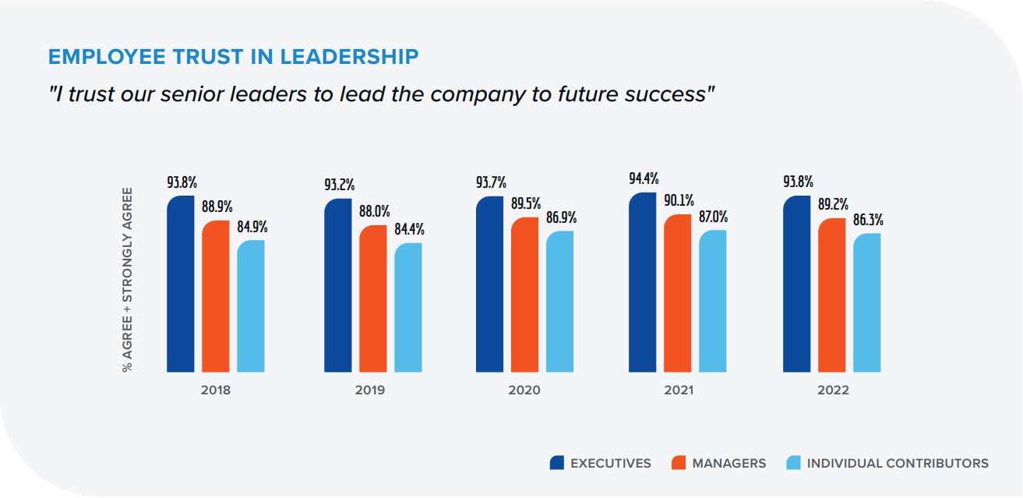
"I trust our senior leaders to lead the company to future success."
2
Trust in
Leadership
Notes:
Shane

Slide 30
Designing for success
Make company vision, strategy, goals, and progress clear
Ensure communication is frequent, transparent, and relevant
Create sustainable communication practices
Listen to employees and acknowledge how you use their feedback
"Talk the talk" and "walk the walk"
Allow employees to see leaders as people
2
Trust in
Leadership
Notes:
Shane
What’s one thing that you’ve seen or experienced that was trust done right? What is one thing that went wrong? Felt toxic?

Slide 31
What is one thing you have seen or experienced that was trust done right?
What is one way trust was done wrong?
2
Trust in
Leadership
Notes:
Shane

Slide 32
3
Employee Recognition
Notes:
Teresa
Is employee recognition a business priority?

Slide 33
Is employee recognition a business priority?
Why? Why not?
3
Employee
Recognition
Notes:
Teresa

Slide 34
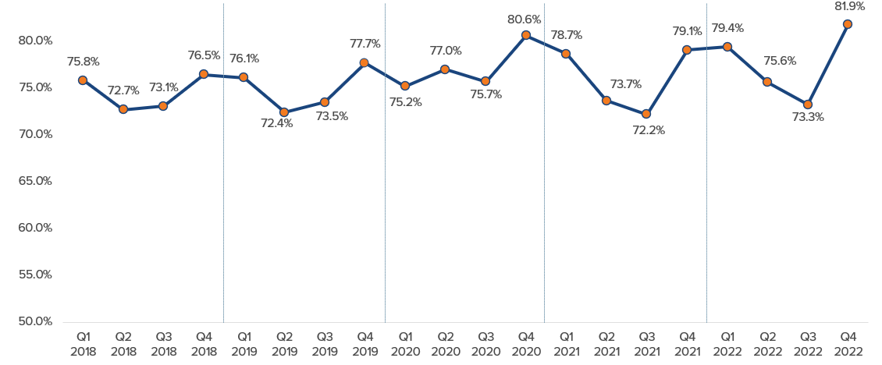
"If I contribute to the organization's success,
I know I will be recognized."
3
Employee
Recognition
When employees believe they will be recognized, they are 2.7x more likely to be highly engaged.
Notes:
Teresa

Slide 35
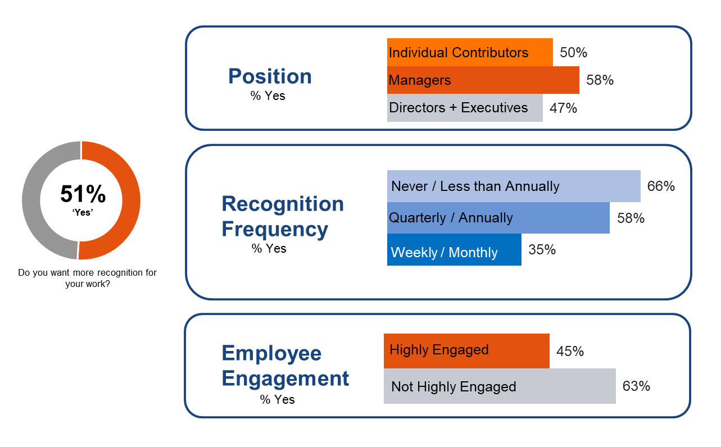
Who wants more recognition at work?
3
Employee
Recognition
Notes:
Position: Managers most likely to say they would like more recognition. While we often think of managers as the ones giving recognition, they also benefit from receiving recognition.
Frequency: Those who don't often receive recognition want more, not surprising...
Engagement: While Highly engaged employees are less likely to say they want more recognition, 45% still say they want more. Those who are not highly engaged are more likely to say, yes, they want more recognition. Which might give a clue as to why they aren't highly engaged. They might not be receiving recognition for the contributions they're making.

Slide 36
Designing for success
Recognize employees for performance core to your mission
Recognize behaviors that align with core values
Think beyond rewards & focus on authentic recognition
Individualize recognition to employee values & preferences
Consider how recognition weaves through all you do
3
Employee
Recognition
Notes:
What’s one thing that you’ve seen or experienced that was recognition done right? What is one thing that went wrong? Felt toxic?

Slide 37
What is one thing you have seen or experienced that was employee recognition done right?
What was one thing that felt wrong or toxic?
3
Employee
Recognition

Slide 38
Question & Response

Slide 39
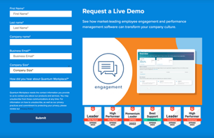
Thank you!
Connect with us on LinkedIn
Learn more about Quantum Workplace
linkedin.com/in/shane-mcfeely
linkedin.com/in/teresapreister/
quantumworkplace.com
Notes:
Anne LinkedIn

