Slide 1
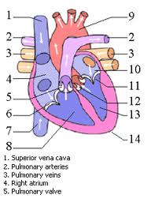
Introduction to A & P
Anatomy is the study of structure
Physiology is the study of how something works
Structure determines function

Slide 2
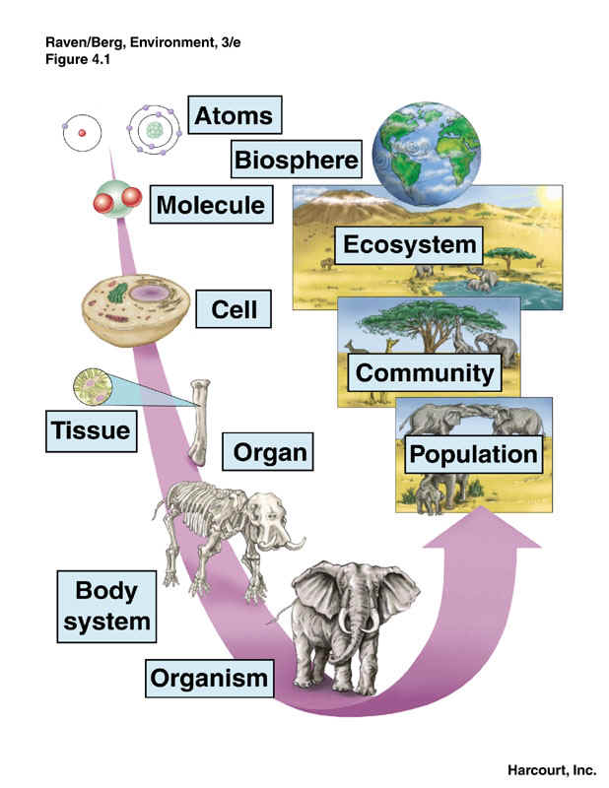
I. Levels of biological organization
Chemical
Cell
Tissue
Organ
Organ system
Organism
Population
Communities
Ecosytems
Biosphere

Slide 3
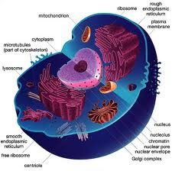
II. Characteristics of life A. Living things are made of cells
1. procaryotic vs. eucaryotic
2. plant vs. animal cells
3. surrounded by a cell membrane that is semipermeable
4. common genetic language
5. science of cellular study is called cytology

Slide 4
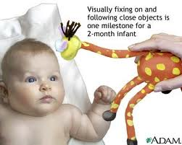
B. Living things respond to their environment

Slide 5
C. Living organisms exhibit respiration
1. organisms take in energy
2. convert energy to build new cells
3. use energy to maintain homeostasis

Slide 6
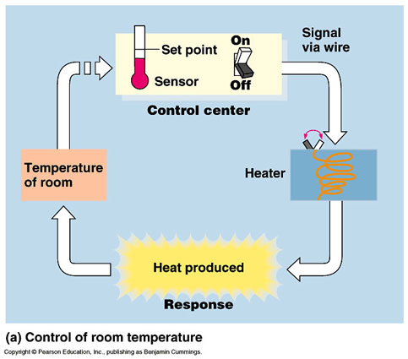
D. Living organisms maintain homeostasis
1. definition
2. maintained by feedback systems
3. components of feedback systems
4. types of feedback systems
a. Negative
B. Positive

Slide 7
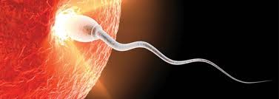
E. Reproduce, grow and develop

Slide 8
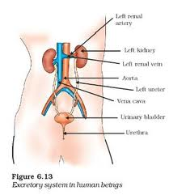
F. Excrete wastes

Slide 9
G. Evolve

Slide 10
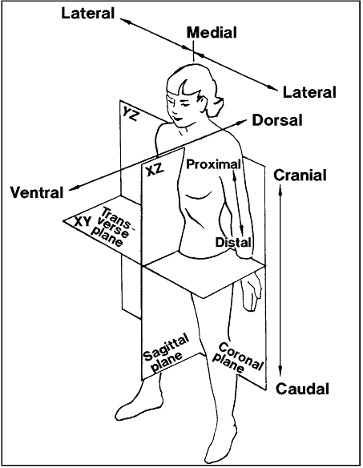
III. Body Planes
Anatomical position
Body planes
1. Longitudinal
a. Sagittal (mid vs. para)
b. Coronal (Frontal)
2. Transverse (Horizontal)

Slide 11
IV. Directional terms
1. lateral vs. medial
2. dorsal vs. ventral
3. anterior vs. posterior
4. cranial vs. caudal
5. superior vs. inferior
6. superficial vs. deep

Slide 12
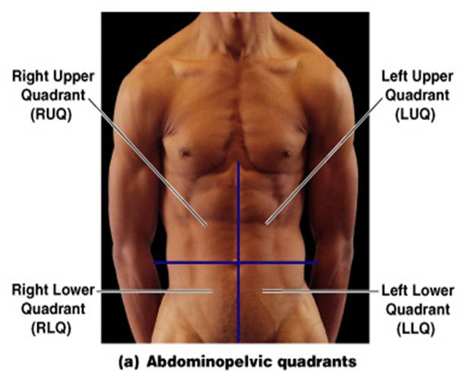
V. Anatomical Regions
1. Abdominolpelvic quadrants

Slide 13
2. Abdominopelvic regions

Slide 14
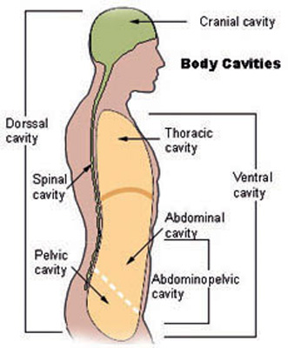
VI. Body Cavities
A. Dorsal body cavity
1. cranial cavity
2. vertebral or spinal cavity
B. Ventral body cavity (viscera)
1. abdominal (peritoneum)
2. thoracic
a. pleural cavities
b. mediastinum

Slide 15
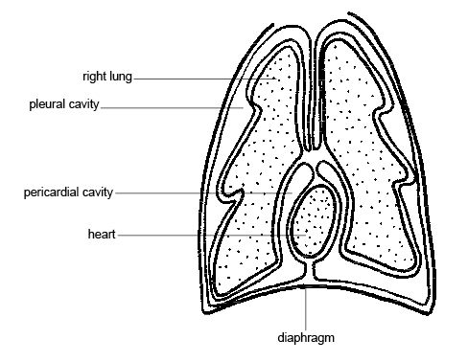
VII. Membranes
A. Mesentery
B. Visceral vs. parietal serosa
C. Hand in balloon
D. Heart membranes
E. Lung membranes
F. Peritoneal membranes
G. Serosal fluid
H. Pleurisy or peritonitis

Slide 16
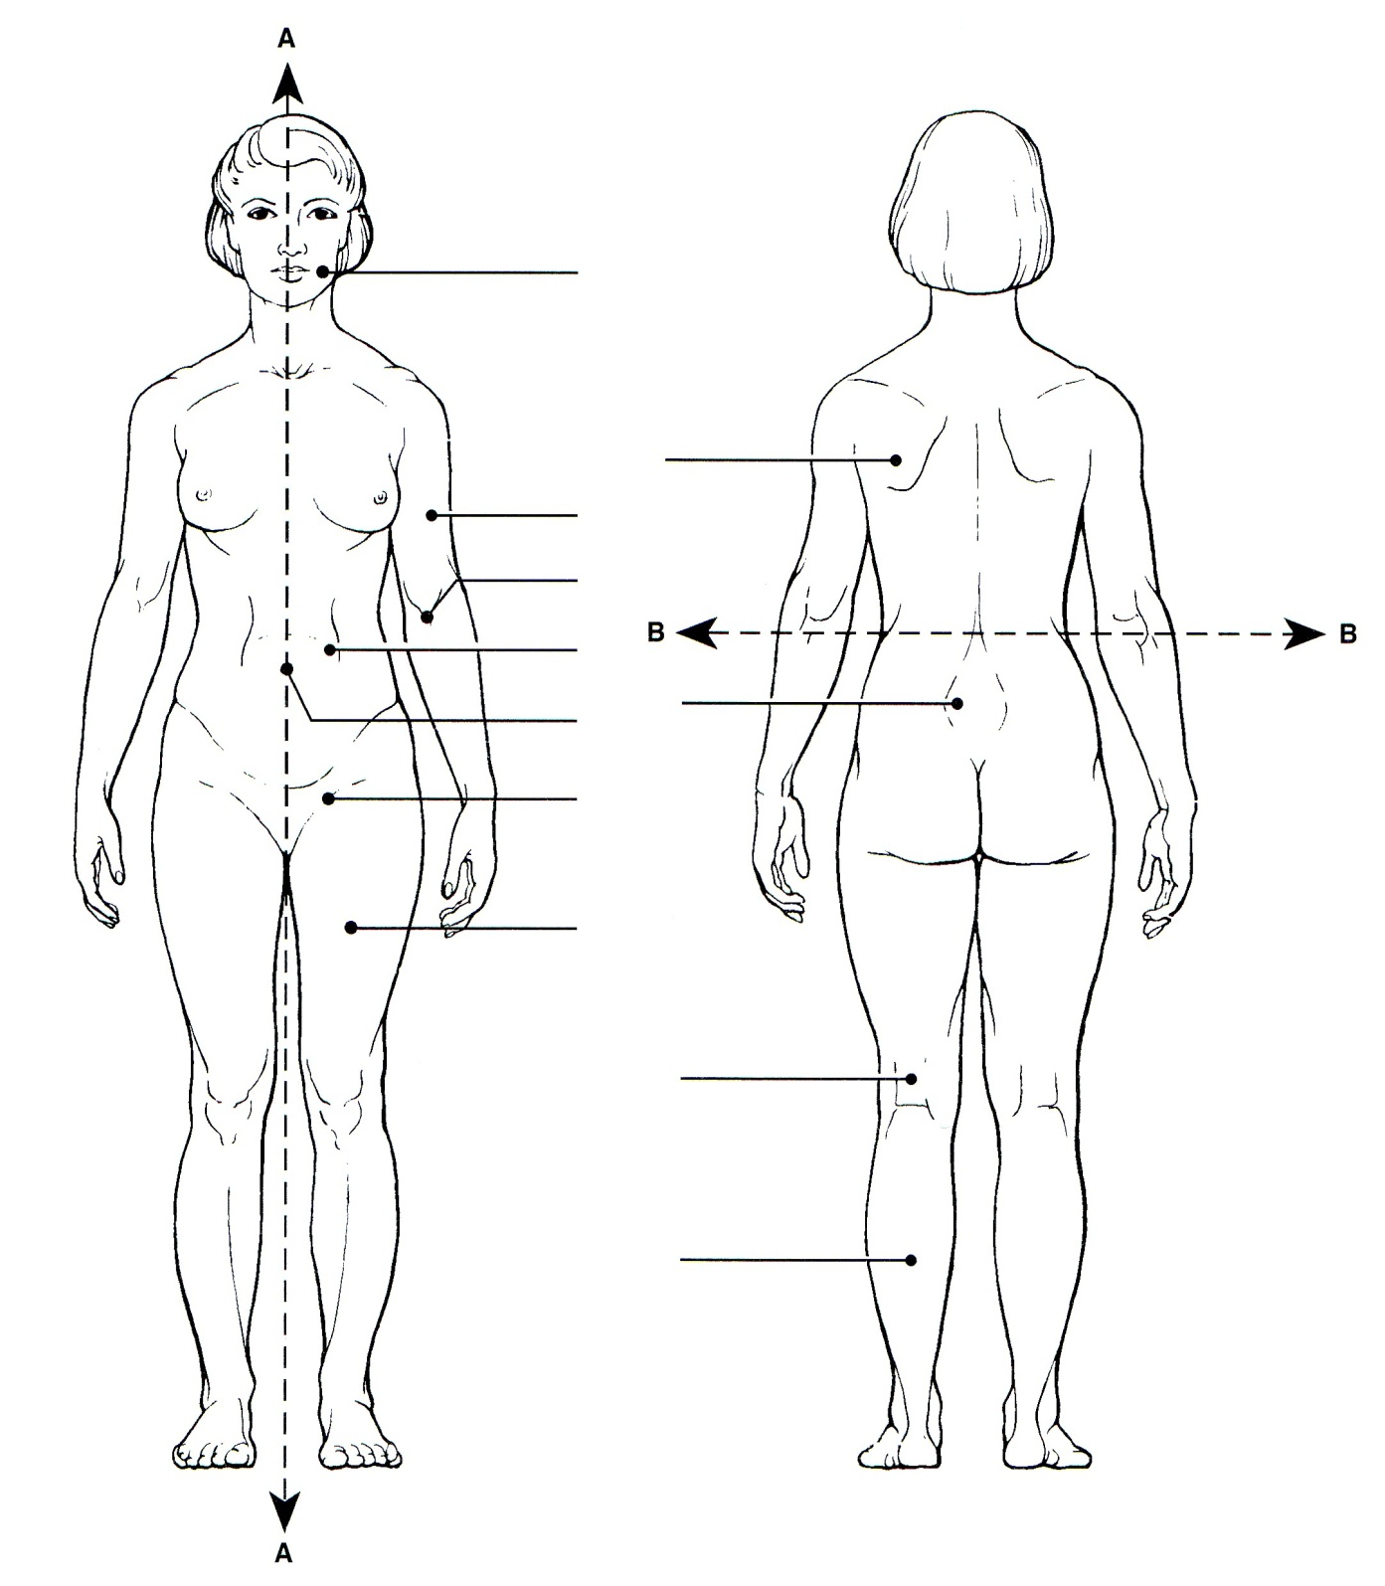
VIII. Body Regions
A. Abdominal
B. Antecubital
C. Axillary
D. Brachial
E. Buccal
F. Cervical
G. Femoral
H. Gluteal
I. Inguinal
J. Lumbar
K. Occipital
L. Popliteal
M. Pubic
N. Scapular
O. Sural
P. Umbilical

