Slide 1
Blood Vessels
What goes around
Comes around

Slide 2
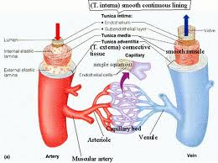
I. Definitions
A. Arteries
B. Arterioles
C. Capillaries
D. Venules
E. Veins

Slide 3
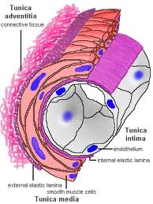
II. Structure of blood vessels
A. Tunica intima-simple squamous epithelium
B. Tunica media-varying amounts of elastin and muscle
C. Tunica externa-supplies nourishment to vessel

Slide 4
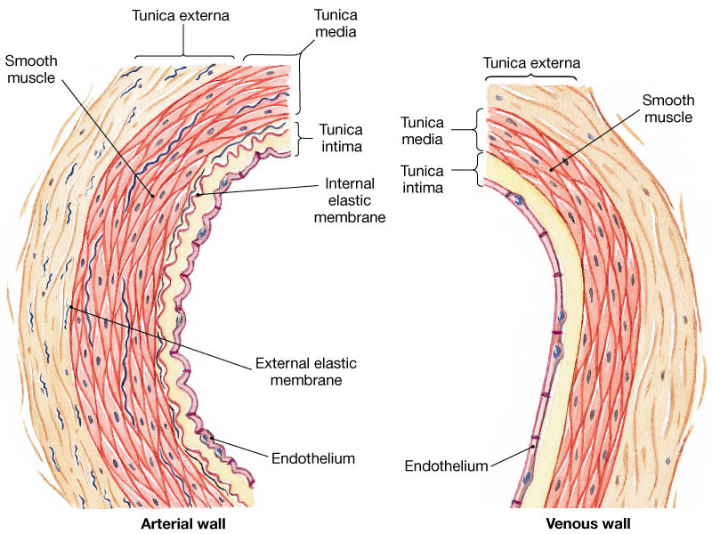
III. Specific functions of vessel type
A. Artery
1. Relatively large individual diameters
2. High pressures
3. Tunica media a lot of elastic fiber
4. Dampens pressure fluctuation
5. Propels blood into vascular tree during diastole
6. Blood pressures

Slide 5
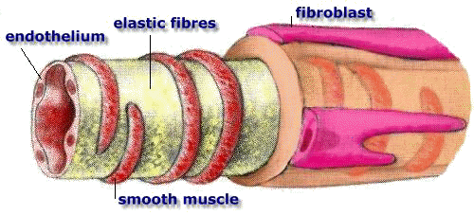
B. Arterioles
1. much less elastic tissue
2. more smooth muscle
3. regulate delivery of blood to tissues
4. function as faucets
5. sympathetic nervous system
6. local factors

Slide 6
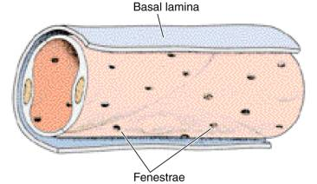
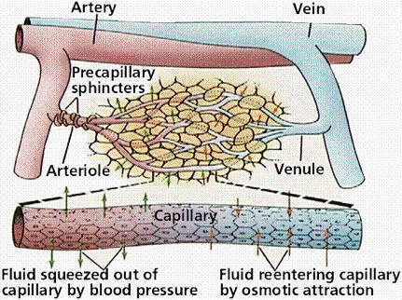
C. Capillaries
1. simple squamous endothelium
2. no smooth muscle
3. function
4. dynamics across bed
5. YouTube microcirculation

Slide 7
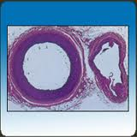
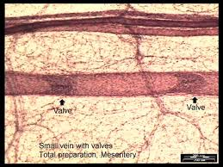
D. Veins
Structure
Valves
Experiment
Blood resevoir

Slide 8
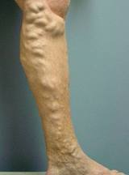
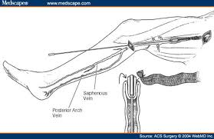
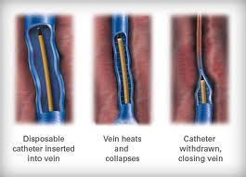
E. Varicosities and treatments
1. example
2. treatment

