Slide 1
Blood
The River of Life

Slide 2
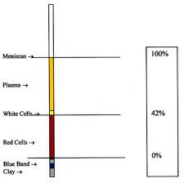
I. Components-connective tissue
A. Formed elements
B. Erythrocytes
C. Buffy coat
D. Plasma

Slide 3
II. Physical traits
A. Sticky
B. Color varies with oxygen load
C. 5X thicker than water
D. pH 7.35-7.45
E. 8% body weight
F. Healthy men 5-6 liters

Slide 4
III. Plasma
A. 90 % water with a lot of solute
B. Stuff dissolved
Gases, electrolytes, hormones, plasma proteins, wastes, nutrients
Proteins most abundant
Albumin-osmotic balance, pH buffering
Clotting factors-fibrinogen
Some hormones
Antibodies-globulins

Slide 5
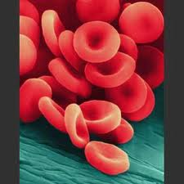
IV. Formed elements
A. Erythrocytes (RBC’s)
1. shape
2. anucleate
3. hemoglobin (13-18 g/ml male
12-16 g/ml female)
4. no internal organelles
5. 5 million/cubic mm
6. anemia
7. http://www.youtube.com/watch?v=mCf6V5RoBEA

Slide 6
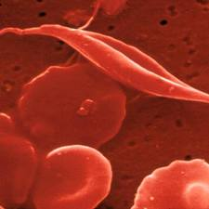
8. sickle cell anemia
Causes
Populations effected
Sickle cell anemia vs trait
Advantages of trait
9. Polycythemia

Slide 7
B. Leukocytes
1. 5,000-10,000 cubic mm
2. complete organelle complement
3. protective moveable army
4. diapedesis
5. positive chemotaxis
6. phagocytosis
7.http://www.youtube.com/watch?v=JnlULOjUhSQ&feature=related

Slide 8
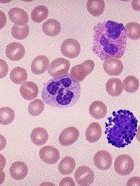
8. Types of leukocytes
a. Granulocytes
Neutrophils are phagocytes of bacteria and fungi
Eosinophils increase in number during parasitic worm infections
Basophils release histamine

Slide 9
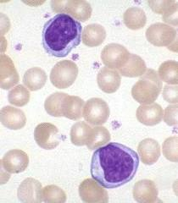
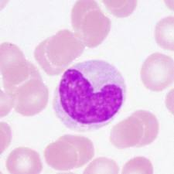
b. Nongranulocytes
Lymphocytes produce antibodies
Monocytes turn into macrophages

Slide 10
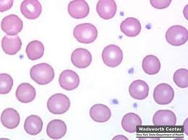
C. Platelets
1. noncellular
2. 300,000/mm
3. required for blood clotting

Slide 11
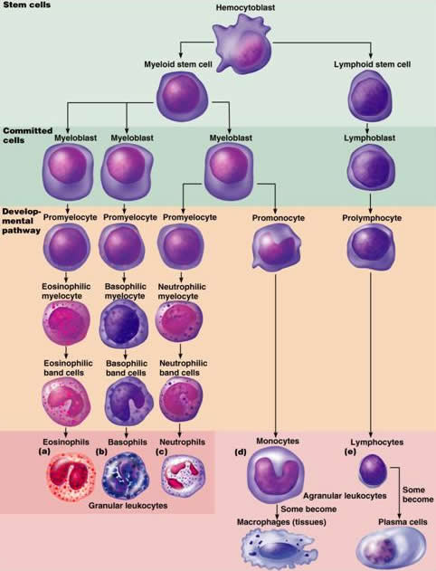
V. Hematopoiesis
1. red bone marrow flat bones skull and pelvis
2. stem cell
3. erythropoietin produced in kidneys
4. thrombopoietin

Slide 12
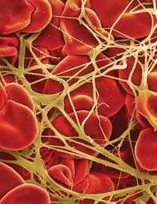
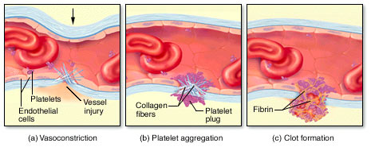
VI. Hemostasis
A. Sequence
1. vascular spasm
2. platelet plug forms
3. coagulation occurs fibrinogen -> fibrin
Platelet plug or thrombus

Slide 13
B. Disorders of hemostasis
1. thrombus
2. embolus
3. thrombocytopenia
4. hemophilia

Slide 14
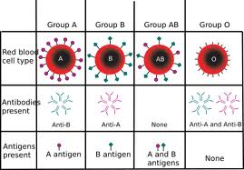
VII. Bood Groupings
A. Definitions
1. antigen
2. antibody
3. agglutination
ABO blood group
1. Type A (40%)
2. Type B (11%)
3. Type AB (4%)
4. Type 0 (45%)

Slide 15
C. Rh factor
1. family of antigens
2. Rhesus monkey
3. positive vs. negative
4. negative does not have antibodies automatically
5. erythroblastosis fetalis

Slide 16
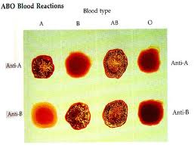
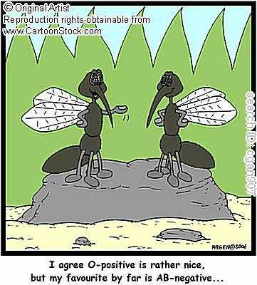
D. Blood typing
1. serum anti-A
2. serum anti-B

