Slide 1
Integumentary System
Skin and its related organs

Slide 2
I. Properties of the skin
1. Waterproof
2. Stretchable
3. Washable
4. Permanent press
5. Autorepair

Slide 3
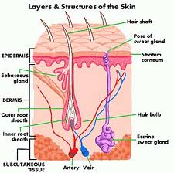
II. Functions of skin
A. Limit dehydration
B. Protection
C. Insulation
D. Sensory receptor
E. Temperature regulator
F. Blood resevoir
G. Excretion

Slide 4
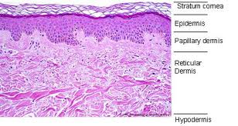
B. Dermis
1. dense irregular connective tissue 2. binds body together
3. hide
4. tanned hides are called leather
5. Papillary
a. Peg-like projection
b. May contain dense capillary beds
c. Touch receptors-Meissner’s corpuscles
d. Dermal ridges on hand and feet

Slide 5
6. Reticular layer
a. 2/3’s thickness of dermis
b. collagen gives strength and binds water
c. elastin stretch recoil
d. lines of cleavage
e. flexure lines-dermal folds

Slide 6
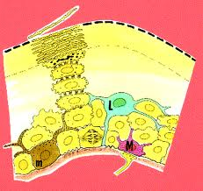
III. Components of skin
A. Epidermis
1. stratified squamous
2. keratinocytes
3. melanocytes
4. Langerhan’s cells
5. Merkel cell
6. Nonvascular

Slide 7
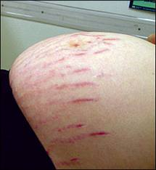
7. Homeostatic imbalance
a. Striae (stretch marks)
b. Blister

Slide 8
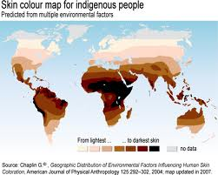
IV. Skin color
A. melanin
1. protective
2. absorbs UV
B. carotene
1. yellow/orange
2. statum corneum
C. hemoglobin

Slide 9
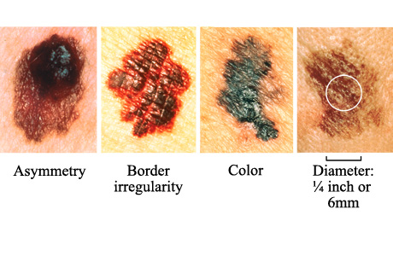
D. Homeostatic imbalance
1. erythema
2. blanching
3. jaundice
4. hematomas
5. melanoma

Slide 10
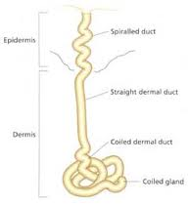
V. Skin appendages-epidermal derivatives
A. Sweat Glands/sudoriferous glands
1. 2.5 million
2. eccrine most numerous type
Release sweat
99% water
Urea
Sympathetic ANS

Slide 11
2. Apocrine sweat glands
a. Located in the anogenital/axillary area
b. Fatty substances and protein
c. Empties into hair follicles
d. Aromatic
e. Ebb and flow with menstrual cycle
f. Development influenced by arrival of sex hormones
g. Scent glands

Slide 12
3. Ceruminous glands
4. Mammary glands

Slide 13
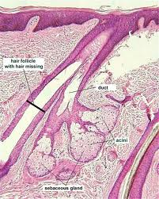
B. Sebaceous Glands
1. all surfaces except palm and plantar surfaces
2. esp. prominent face, neck, upper chest
3. secrete sebum into hair follicles
4. oilish dead remains of glandular cells
5. functions:
a. Moisturizes skin and hair
b. Waterproofs
c. Bacteriostatic

Slide 14
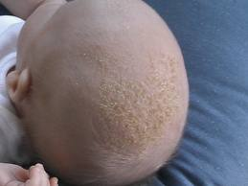
6. Imbalance terms
a. Whitehead
b. Blackhead
c. Acne
d. Seborrhea/cradle cap

Slide 15
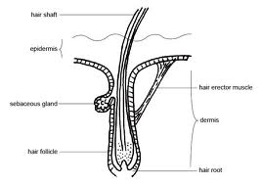
C. Hair follicles
1. epidermal derivative
2. shaft
3. arrector pili
4. bulb
5. functions
a. Sunscreen
b. Protection
c. Sensory
d. Insulation

Slide 16
VI. Burns
A. Problems
1. loss of body fluids
2. electrolyte disruption
3. renal shutdown
4. circulatory shock
Needs
1. Fluid replacement
2. Huge caloric supplements
3. Infection control after 24 hours

Slide 17
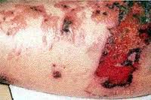
C. Level of Severity
1. first degree burn
2. second degree burn-blisters
3. third degree burn
4. partial versus full thickness burns

Slide 18
VII. Temperature regulation
A. Components of feedback loop
1. receptor
2. afferent pathway
3. control center
4. efferent pathway
5. effector
6. response or product

Slide 19
B. Body temperature results from balance between heat production and heat loss
1. Body at rest most of heat produced is generated by
a. Liver
b. Heart
c. Brain
d. Endocrine organs
e. Inactive muscle 20% of body heat
2. Vigorous exercise skeletal muscle can produce 30-40X the heat that the above sources produce

Slide 20
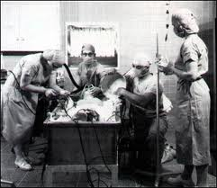
C. Normal body temperature 98.6
1. does range between 96-100 degrees
2. lowest in morning
3. high temperature late in afternoon
4. important to keep temperature in this range
5. for each 1 degree rise in temperature, metabolic rate increases 10%
6. Above homeostatic range, nervous activity becomes depressed and body proteins break down
7. 106 convulsions
8. 110 absolute limit for life
9. can withstand cooling much better

Slide 21
D. Core and shell temperature
1. core highest temperature-organs within body cavities
a. Temperature taken to measure health
b. Oral temperature often .7 degrees cooler than rectum
2. shell-skin represents the heat loss surface
a. Usually cooler than core
b. Varies widely with need to regulate
c. Varies 68-104

Slide 22
E. Heat promoting effectors
1. vasoconstriction of cutaneous vessels
2. increase in metabolic rate with increased activity of the sympathetic nervous system
3. Shivering
4. Increased thyroid activity

Slide 23
F. Heat loss mechanisms
1. vasodilation of cutaneous vessels
2. enhanced sweating

Slide 24
G. Homeostatic imbalance
1. hyperthermia
a. Elevated body temperature
b. Deactivates hypothalamus which is the control center for temperature regulation
c. Heat control suspended
d. Creates positive feedback cycle
e. Increasing temperatures increase metabolic rate
f. Increases heat production
g. Skin becomes hot and dry

Slide 25
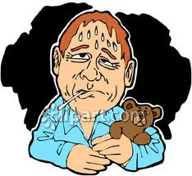
2. Fever
a. Controlled hyperthermia
b. Results from infection
c. WBC’ and other tissues release pyrogens (fire starters)
d. Hypothalamus thermostat reset
e. Body promotes heat promoting efforts
Vasoconstriction and shivering
Temperature rises
f. Increased temperature increases metabolic rate speeding rate of healing
g. Inhibits bacterial growth

