Slide 1
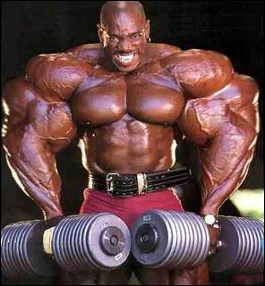
Muscle Matters

Slide 2
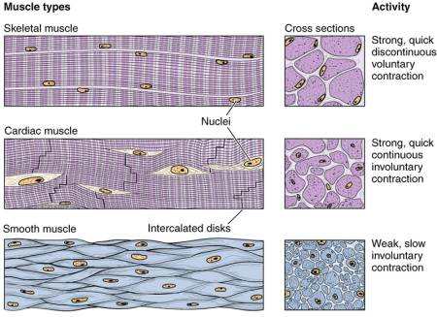
I. Muscle types
A. Skeletal
1. voluntary
2. striated
3. structure
B. Visceral
1. involuntary
2. smooth
3. structure
C. Cardiac
1. location
2. structure

Slide 3
II. Muscle function
A. Producing movement
1. skeletal
2. peristalsis
3. blood movement
B. Maintaining posture and position
C. Stabilizing joints
1. some joints have relatively poorly fitting articular surfaces
2. knee joint
D. Producing heat
E. Additional functions
1. protection
2. sphincters
3. arrector pili

Slide 4
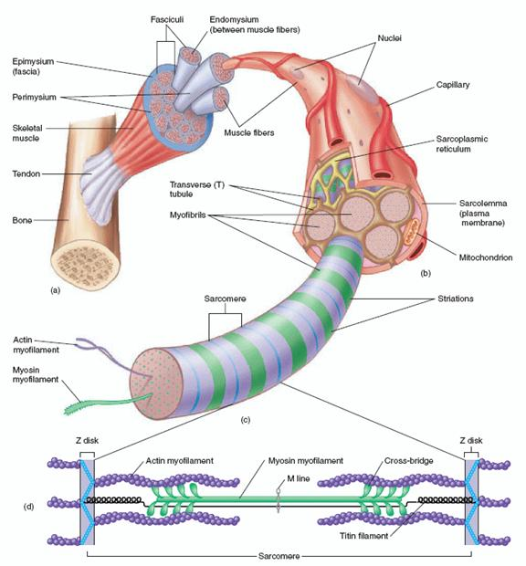
III. Organization of skeletal muscle
A. Fasicle
B. Epimysium
C. Perimsyium
D. Endomysium
E. Tendon
F. Sarcoplasmic reticulum
G. Myofibrils
1. actin
2. myosin

Slide 5
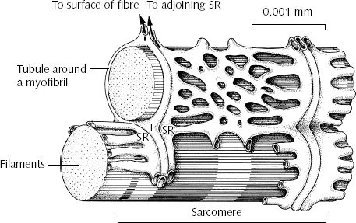
IV. Microscopic structure of voluntary muscle
A. Sarcoplasmic reticulum
1. structure
2. function

Slide 6
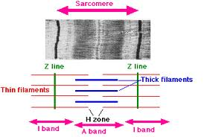
B. Structure of sarcomere
1. sarcomere
2. Z lines
3. I bands
Light bands
actin
4. A bands
Dark bands
myosin

Slide 7
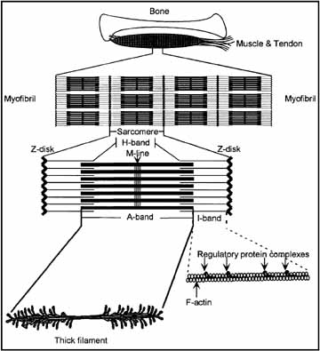
Another View of a Sarcomere
A. Myosin
1. thick myofilament
2. cross bridges
3. ATPase enzymes
B. Actin
1. receptor sites
2. regulatory proteins

Slide 8
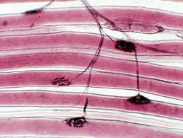
V. Muscle-Nerve Connection
A. Motor unit
1. Definition
2. Size

Slide 9
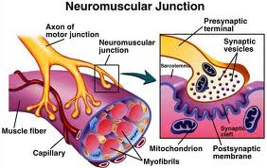
B. Myoneural junction
1. neuromuscular junction
2. neurotransmitter-acetycholine
3. synaptic cleft
4. subneural folds

Slide 10
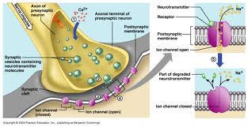
VI. Events at myoneural junction
A. Impulse arrives
B. Ca ion channels open
C. Rupture of synaptic vesicles
D. Ach diffuses
E. Ach attaches to receptor sites
F. Action potential generated on sarcolemma
G. Cholinesterase

Slide 11
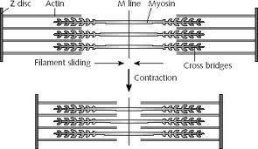
VII. Sliding filament theory
A. Ca ions released from SR
B. Receptor sites on actin opened
C. Cross bridges on myosin attach to actin
D. Power stroke pulling actin toward middle of sarcomere
E. Ca ions reabsorbed at end of nerve stimulation

Slide 12
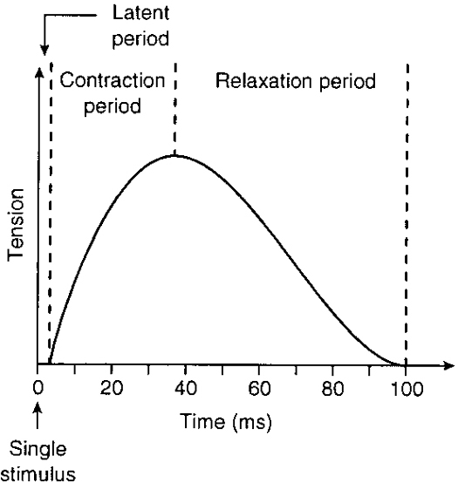
VIII. Contraction of whole muscle A. Muscle twitch
1. motor unit responds with all or none response
2. either occurs or it doesn’t
3. why don’t we move in jerky fashion

Slide 13
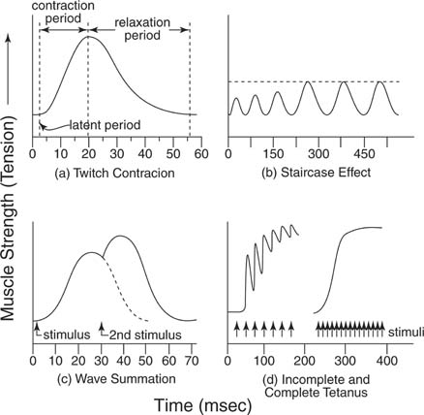
B. Muscle summation
1. simple twitch
2. staircase
3. wave summation
4. tetanus

Slide 14
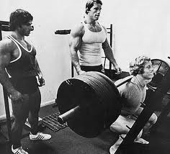
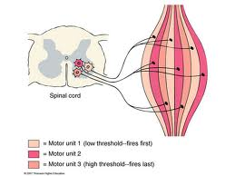
C. Motor unit recruitment
1. definition of motor unit
2. all operate on an all-or-none fashion
3. low threshold
4. mid threshold
5. high threshold

Slide 15
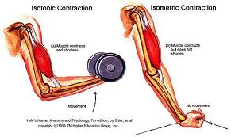
D. Isotonic vs. isometric contraction
1. isotonic contraction
2. isometric contraction

Slide 16
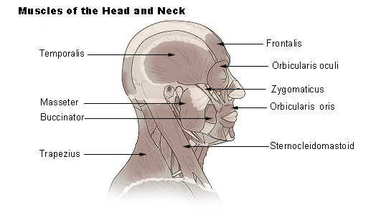
IX. Selected gross anatomy A. Head and neck
1. frontalis
2. orbicularis oculi
3. orbicularis oris
4. zygomaticus
5. buccinator
6. masseter
7. temporalis
8. sternocleidomastod
9. trapezius

Slide 17
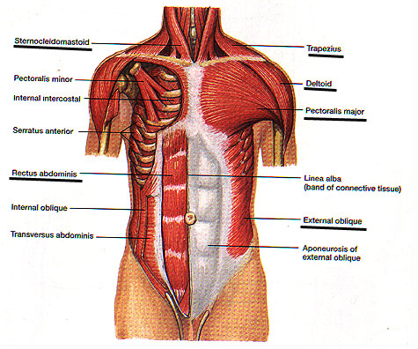
B. Anterior Trunk Muscles
1. pectoralis major
2. deltoid
3. external obliques
4. rectus abdominis

Slide 18
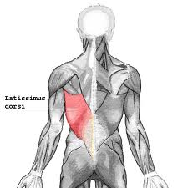
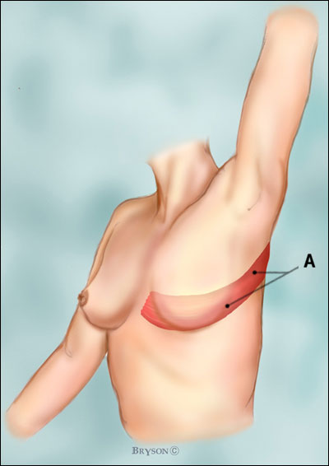
C. Posterior trunk muscles-latissimus dorsi
1. arm pulling down as in striking a blow

Slide 19
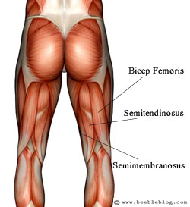
D. Leg muscles posterior
1. gluteus maximus
2. gluteus medius
3. hamstrings
4. gastrocnemius

Slide 20
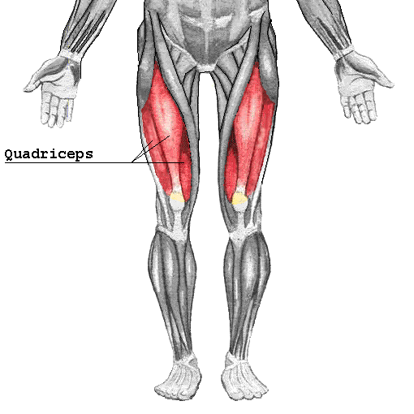
E. Leg muscles anterior
1. quadriceps
2. tibialis anterior

