Slide 1
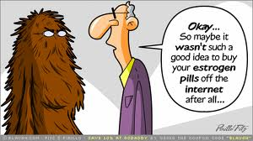
Reproductive Biology

Slide 2
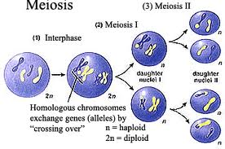
I. Need for Meiosis
A. Human chromosome number = 46
B. Mitosis
C. Meiosis
1. purpose
2. location
3. difference in male and female meiosis

Slide 3
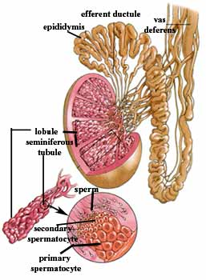
II. Male parts A. Testes
1. produces sperm in seminiferous tubule
2. approximately 700 feet long
3. site of male meiosis
4. interstitial cells also located in testes
5. producers of testosterone

Slide 4
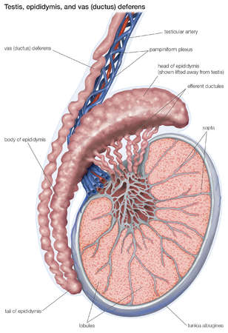
B. Epididymis
1. location
2. 20 feet
3. twenty days to pass through
4. undergo maturation
5. storage organ
6. contracts upon ejaculation sending sperm on to next part of journey

Slide 5
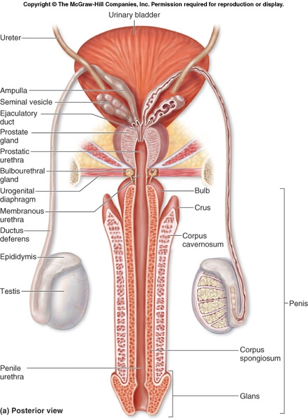
C. Vas deferens or ductus deferens
Travels from epididymis to urethra
Travels through the inguinal canal with the spermatic cord-blood vessels and nerves
Expands into the ampulla
Then enters ejaculatory duct

Slide 6
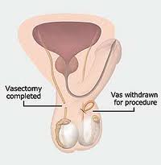
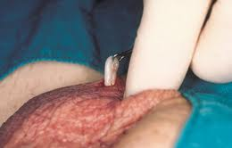
5. Vasectomy
Part of vas lies in scrotum
Local
Small incision
Cuts and ligates
Sterile but not impotent

Slide 7
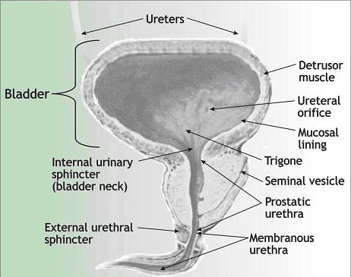
D. Urethra
Prostatic urethra
Membranous urethra
Spongy or penile urethra
Carries both sperm and urine
Never at same time

Slide 8
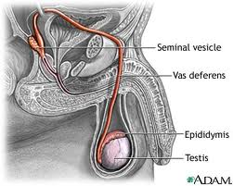
E. Accessory glands producing semen
1. seminal vesicles
a. Produce 60% of semen
b. Thick yellowish secretion
c. Rich in sugar, vitamin C, and prostaglandins
d. Nourish and activate sperm
e. Joins vas deferens on either side to form ejaculatory duct

Slide 9
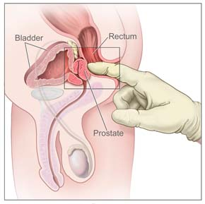
2. Prostate gland
Doughnut shaped
Size of peach pit
Milky alkaline fluid that activates sperm
Approximately 40% of semen
Anterior to rectum is able to be palpated by digital exam
Hypertrophy

Slide 10
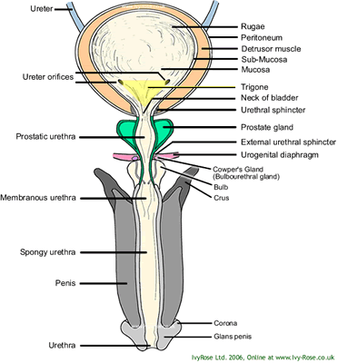
3. Bulbourethral glands
Also called Cowper’s glands
Base of prostate-size of peas
First to empty with ejaculation
Cleanse and neutralizes penile urethra
Also minor lubricant for coitus

Slide 11
4. Seminal fluid
Mature sperm are streamlined missiles
Need nutrient source-fructose from seminal vesicle
Need buffer from prostate
Prostaglandins cause smooth muscle to contract
Fibrinogen and profibrinolysin
Inhibitors of female immune system
Dilutes sperm

Slide 12
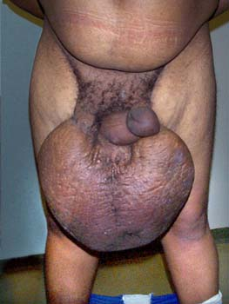
F. Male parts
1. scrotum
a. Air conditioner
b. Rather exposed
c. Cooler temperatures
d. Best produced 93 degrees
e. Bikers’ problems

Slide 13
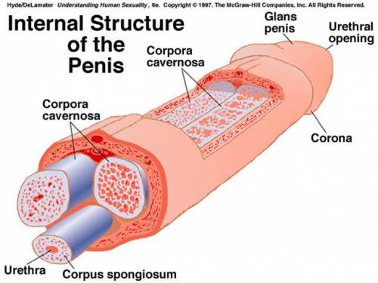
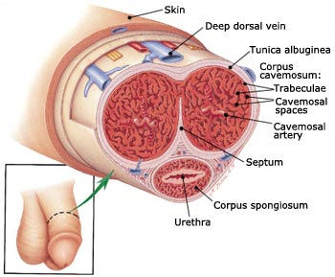
2. Penis
Corpora cavernosa
Corpus spongiosum
Urethra
Glans penis
Prepuce
Mechanics of an erection

Slide 14
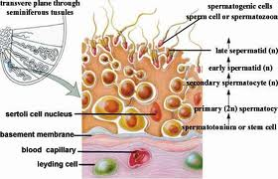
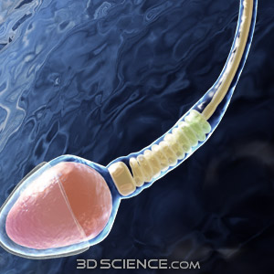
G. Spermatogenesis
1. occurs in seminiferous tubule
2. spermatozoa
a. acrosome
b. head
c. midpiece
d. flagella

Slide 15
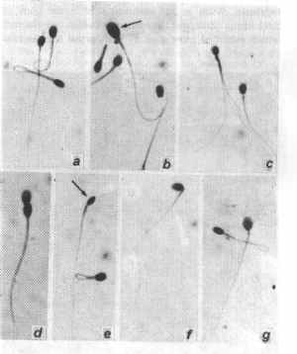
3. Defective sperm and numbers
Defective morphology
Low sperm count
10 million/ml
Varicocoel
Cryptochordism
Retrograde ejaculation

Slide 16
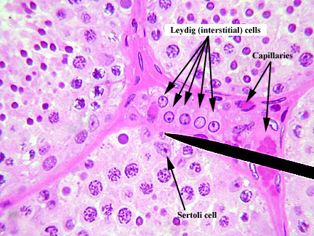
H. Testosterone production
Interstitial cells of Leydig
In response to LH production by the anterior pituitary
Occurs at about the age of 12
Maturation of male reproductive parts
Stimulates production of sperm along with FSH
Produces male secondary sexual traits such as hair growth patterns, deepening of the voice, skeletal muscle development

Slide 17
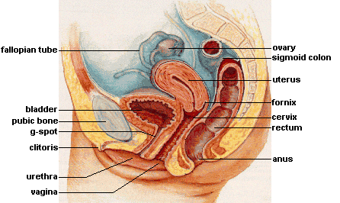
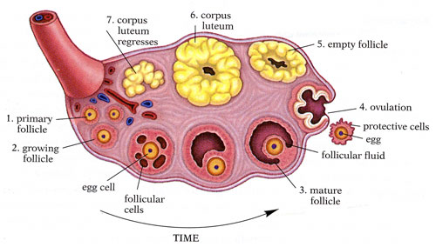
III. Female parts
Ovary
1. ovarian follicles
2. oocyte and follicular cells
3. antrum with follicular fluid
4. Graafian follicle
5. ovulation
6. corupus luteum

Slide 18
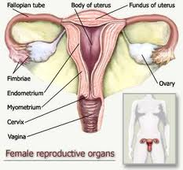
B. Duct system
Fallopian tubes
Fimbriae
Uterus
a. Body, fundus, cervix
b. Endometrium, myometrium
Vagina-birth canal

Slide 19
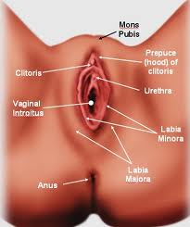
C. Female external genitalia
Mons pubis
Labia majora
Labia minora
Vestibule
Clitoris
Perineum

Slide 20
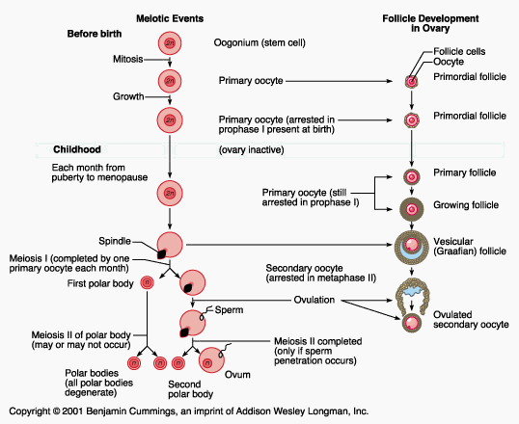
IV. Female reproductive functions
Oogenesis
Oogonium
Primary oocyte
Meiosis I
ovulation
Meiosis II

Slide 21
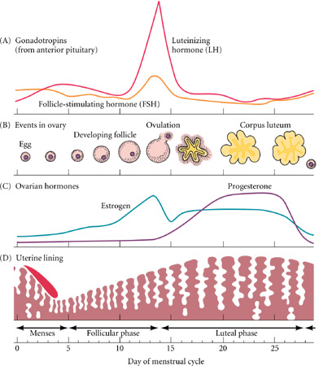
B. Hormonal interactions
Pituitary hormones
Ovarian events
Ovarian hormone fluctuations
Uterine lining evernts

Slide 22
And then there was baby
http://www.evtv1.com/player.aspx?itemnum=735

Slide 23
Fetal development
http://www.youtube.com/watch?v=RS1ti23SUSw

