Slide 1
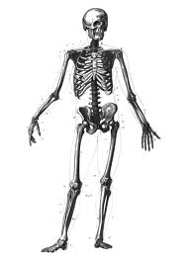
Skeletal System

Slide 2
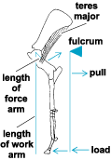
I. Functions of bone
A. Support
B. Protection
C. Movement-lever system
D. Storage
E. Blood cell formation

Slide 3
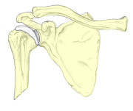
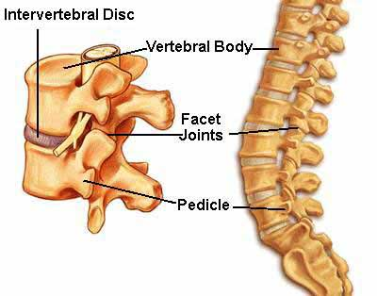
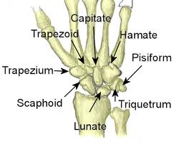
II. Classification of bones
A. Long bone
B. Flat bone
C. Short bone
D. Irregular bone

Slide 4
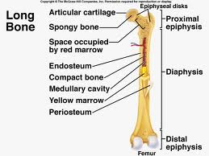
III. Gross Anatomy of a Long Bone
A. Diaphysis
B. Periosteum
C. Epiphyses
D. Articular cartilage
E. Epiphyseal plate
F. Medullary cavity

Slide 5
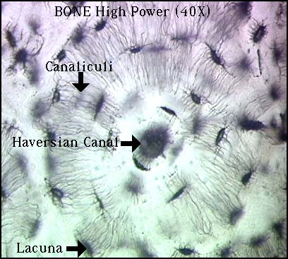
IV. Microscopic anatomy-Haversian units
A. Haversian unit
B. Haversian canal
C. Osteoblast/cyte
D. Canaliculi
E. Lamellae

Slide 6
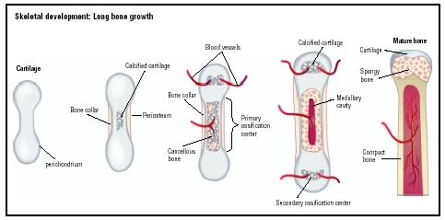
V. Bone growth-endochondral ossification
A. Fetal cart.
B. Boney collar
C. Primary ossifiation center
D. Secondary center
E. Epiphyseal plate
F. Appositional growth-
Osteoclasts vs. osteoclasts
Bone remodeling

Slide 7
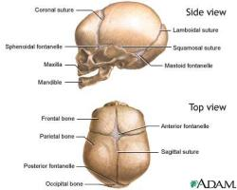
VI. Intramembranous ossification
A. Soft spot
B. Sites of eventual suture lines
C. Allows for compression during birth
D. Allows for growth of brain during first year

Slide 8
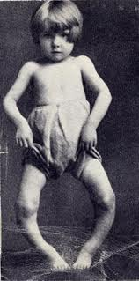
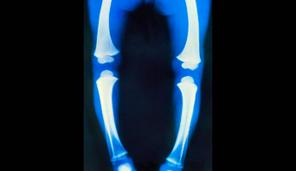
VI. Rickets
A. Children’s disease
B. Failure to calcify
C. Lack of calcium
D. Lack of vitamin D
E. Sunlight

Slide 9
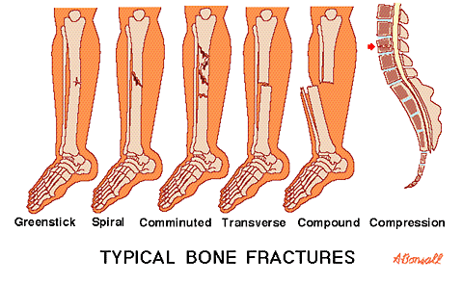
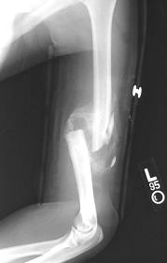
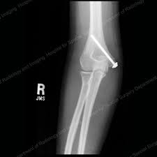
VII. Fractures
A. Greenstick
B. Spiral
C. Comminuted
D. Transverse
E. Compound

Slide 10
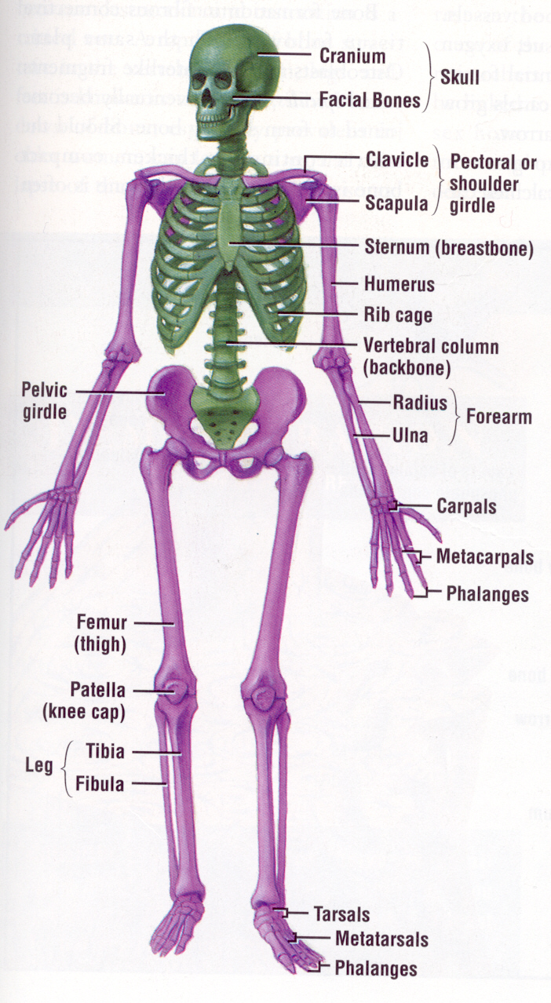
VIII. Divisions of the skeleton
A. Axial-forms the longitudinal axis of the body
1. skull
2. vertebral column
3. thoracic cage
B. Appendicular-appendages and girdles

Slide 11
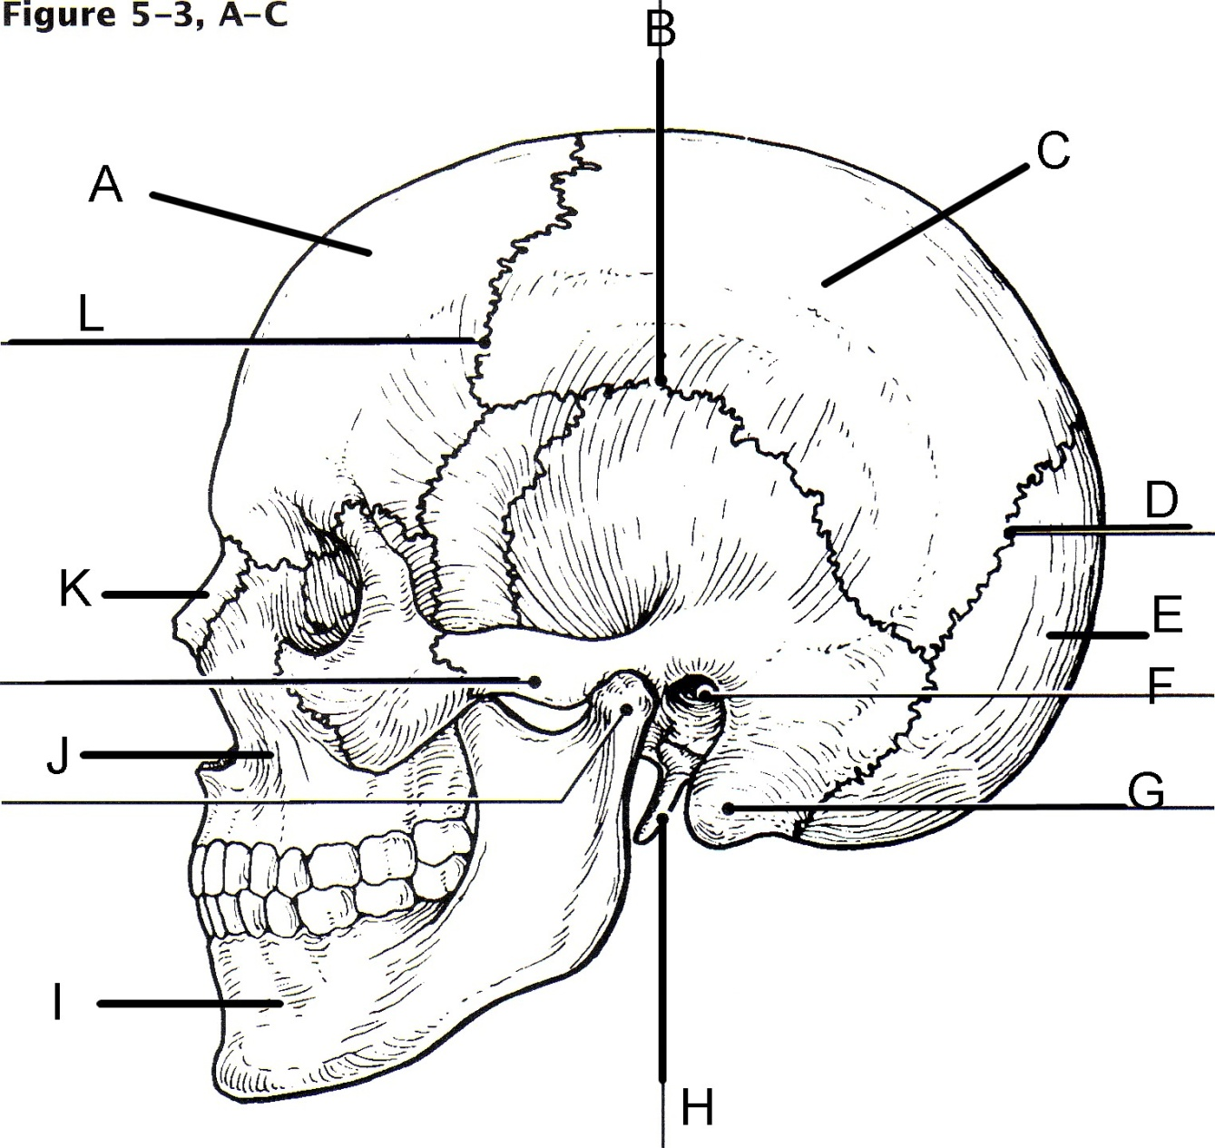
IX. Skull
Frontal Bone
Squamousal suture
Parietal bone
Lambdoid suture
Occipital bone
External auditory meatus
Mastoid process
Styloid process
Mandible
Maxilla
Nasal
Coronal suture

Slide 12
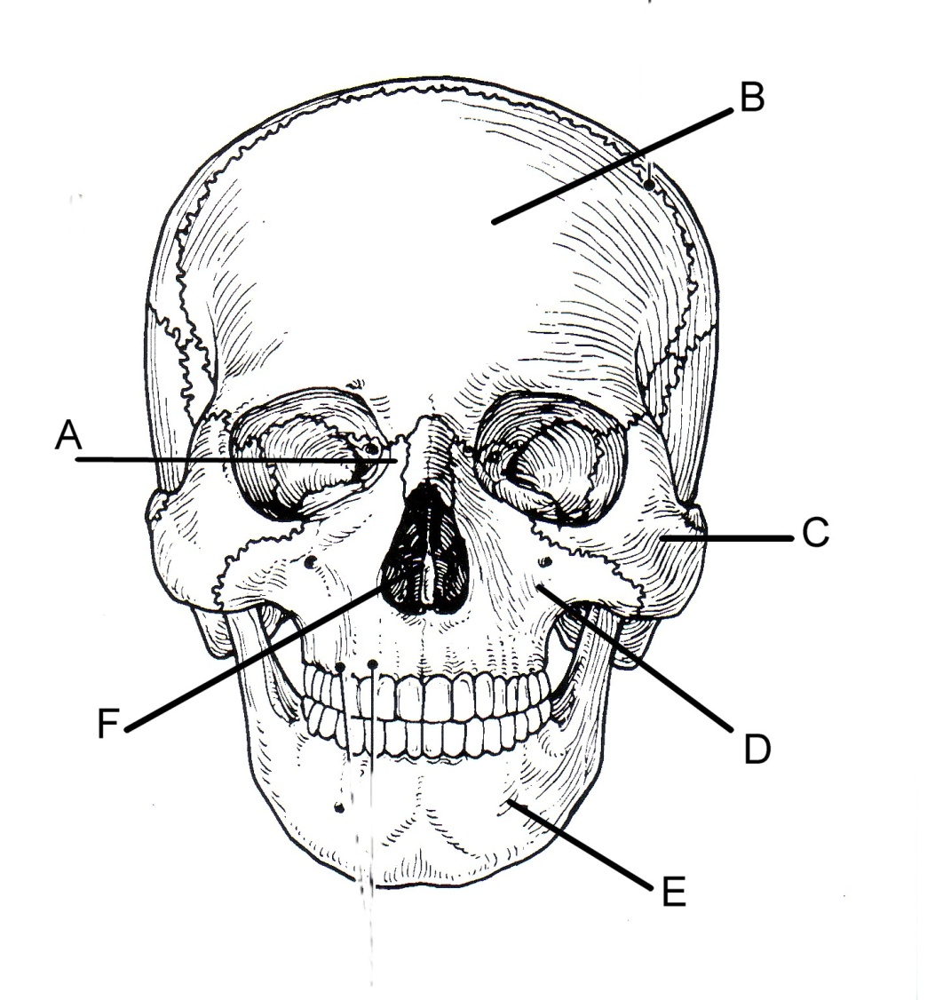
A. Nasal bone
B. Frontal
C. Zygomatic
D. Maxilla
E. Mandible
F . Perpendicular plate of ethmoid

Slide 13
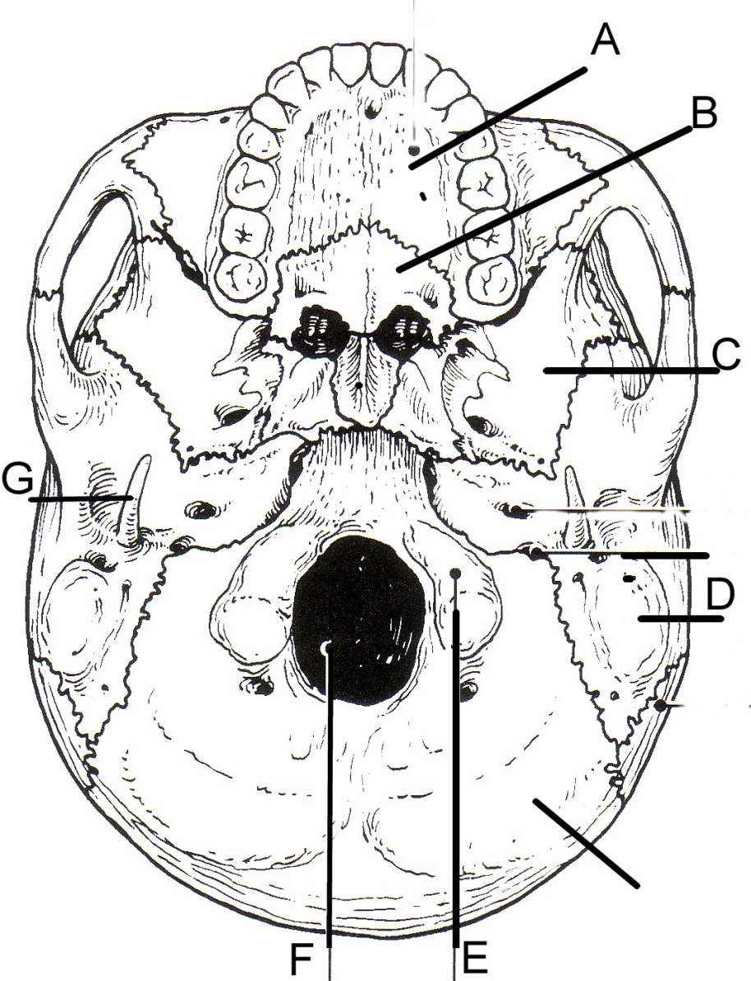
Skull Inferior View
A. Maxilla
B. Palatine
C. Sphenoid
D. Mastoid
E. Occipital Condyle
F. Foramen magnum
G. Styloid process

Slide 14
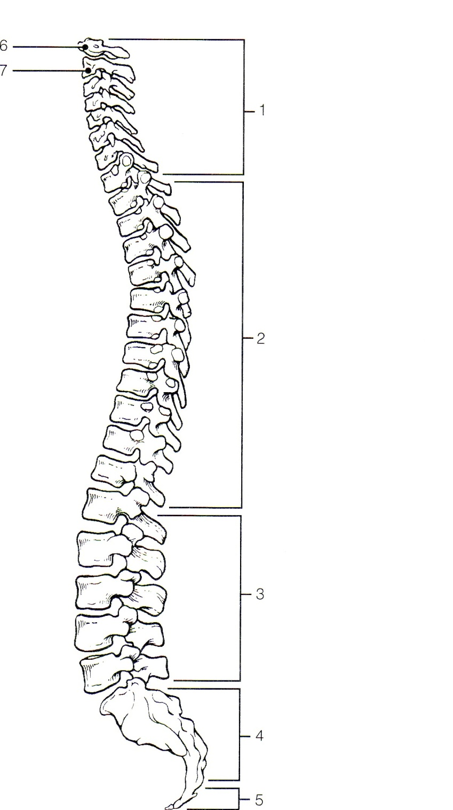
X. Vertebral column A. Regions
1. Cervical-7
2. Thoracic-12
3. Lumbar-5
4. Sacral-5 fused
5. Coccyx-4 fused
6. Atlas
7. Axis

Slide 15
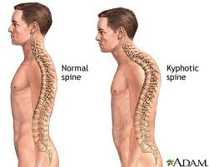
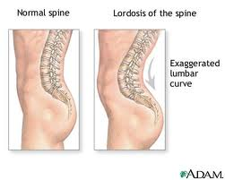
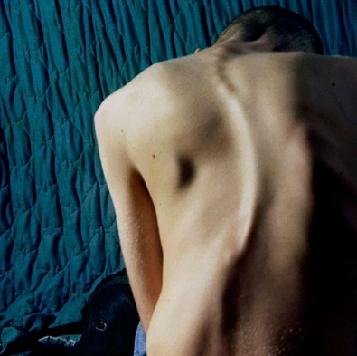
B. Abnormal spinal curvatures
1. kyphosis
2. lordosis
3. scoliosis

Slide 16
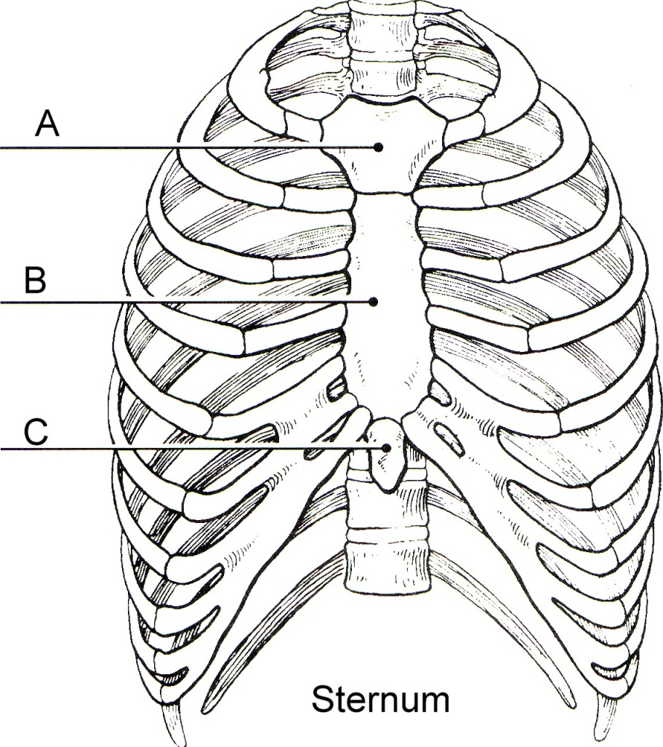
XI. Sternum
A. Manubrium
B. Body
C. Xiphoid process
D. True ribs
E. False ribs
F. Floating ribs
G. Jugular notch
H. Sternal angle
I. Sternal puncture

Slide 17
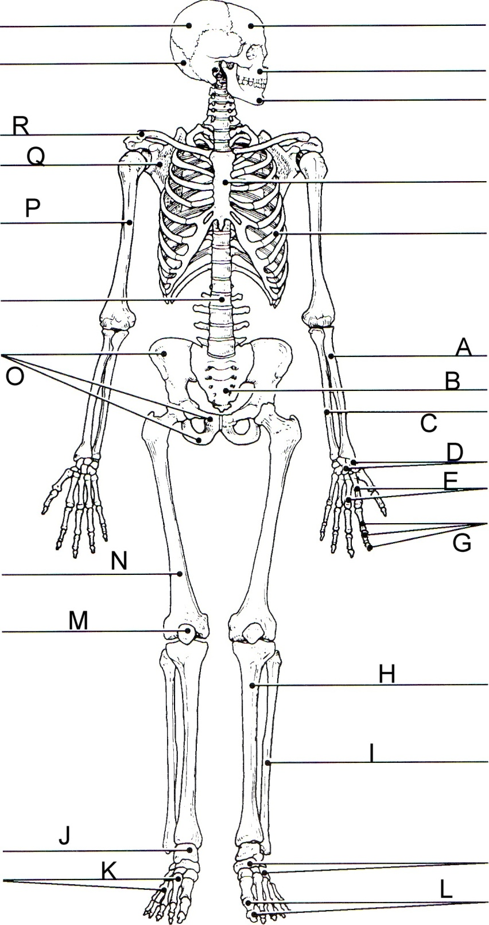
XII. Skeleton
A. Radius
B. Sacrum
C. Ulna
D. Carpals
E. Metacarpals
G. Phlanges
H. Tibia
I. Fibula
J. Tarsals
K. Metatarsals
L. Phlanges
M. Patella
N. Femur
O. Pelvic girdle
P. Humerus
Q. Scapula
R. Clavicle

Slide 18
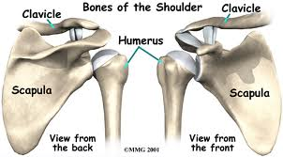
Pectoral Girdle

Slide 19
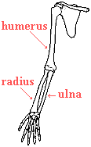
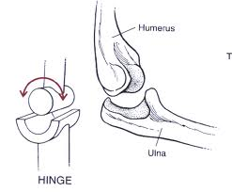
Elbow Joint

Slide 20
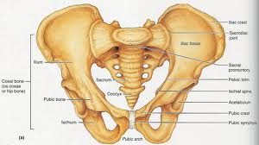
Pelvic Girdle

