Slide 1
Special Senses

Slide 2
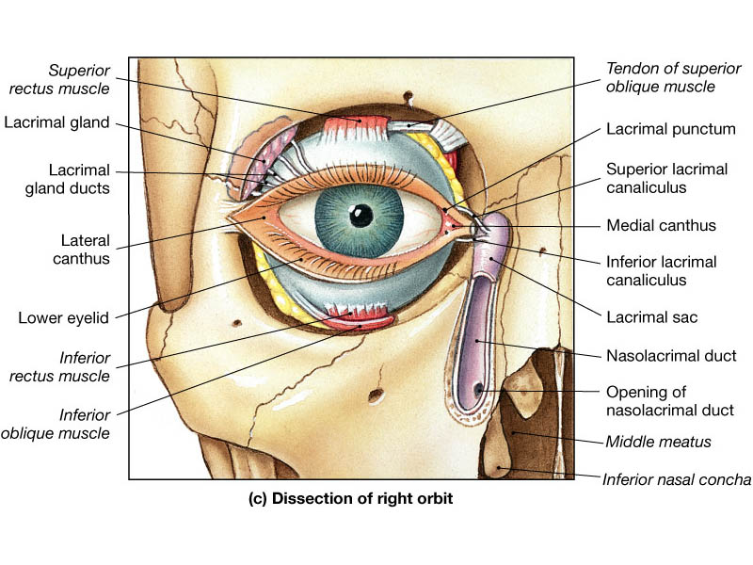
I. Eye A. Accessory Structures
1. Eyebrows
a. Sunshades
b. Keep perspiration out
2. Eyelids or palpebrae
a. Protective reflex
b. Blinking spreads tears
c. Eye lashes and ciliary glands (sweat glands)
d. Meibomian glands (sebaceous glands)
3. Conjunctivia
4. Lacrimal apparatus

Slide 3
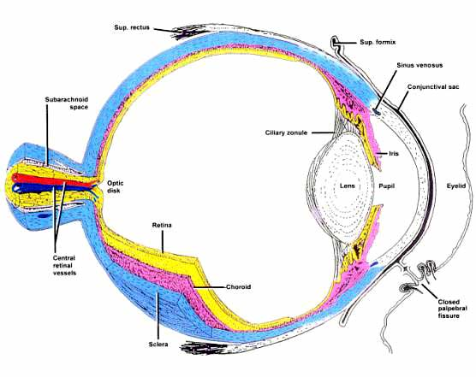
B. Eye structure-composed of three tunics
1. fibrous tunic
a. Sclera-white of the eye
b. Cornea transparent portion (focuses, nonvascular)
2. vascular tunic (contains most of the blood vessels)
a. Very black due to a lot of melanin
b. Portion associated with sclera is called choroid coat
c. Anteriorly vascular tunic is modified to form ciliary body
d. Ciliary body is a sphincter muscle and also produces aqeous humor
e. Iris is also part of the vascular tunic

Slide 4
3. Sensory tunic-retina
a. 120 million rods-black white
b. 7 million cones-color
c. Macula lutea
d. Fovea centralis
e. Optic disk or blind spot

Slide 5
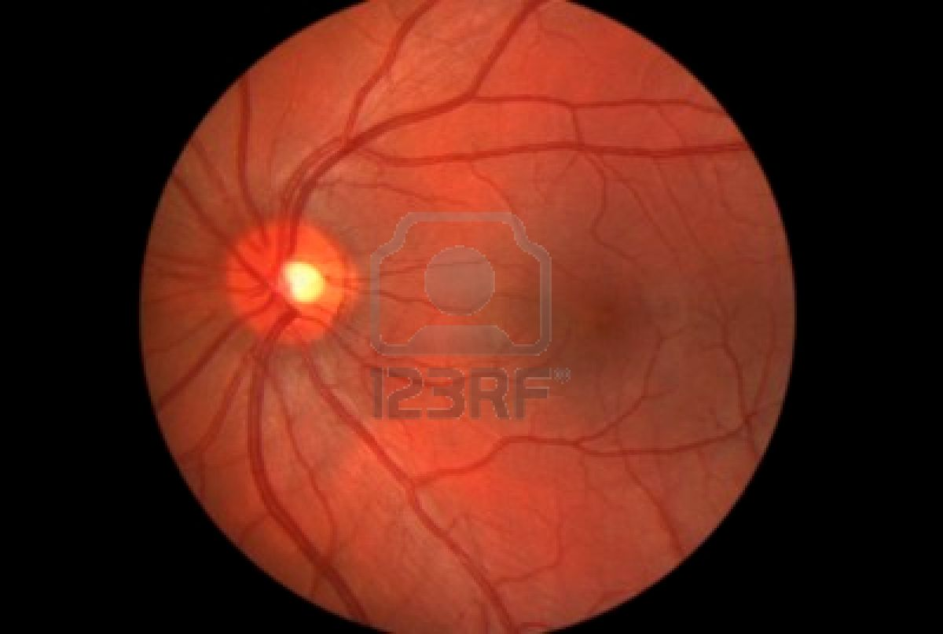

Slide 6
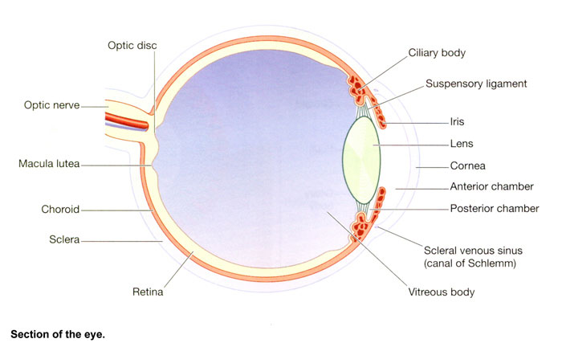
4. Chambers of the eye
a. Anterior chamber
b. Posterior chamber
c. Aqueous humor-ciliary body and the canal of Schlemm
d. Vitreous chamber-filled with vitreous humor

Slide 7
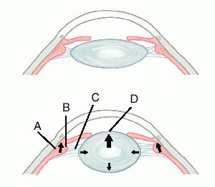
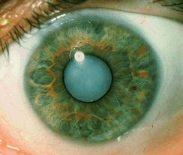
5. lens-nonvascular
a. Attached to ciliary body by suspensory ligaments
b. Lens is elastic
c. Fine focus of the scope
d. Flatter for distance vision
e. Greater curvature for close vision
f. cataract

Slide 8
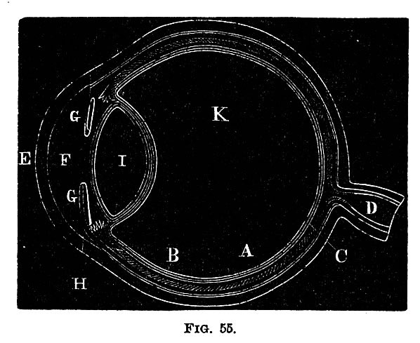

Slide 9
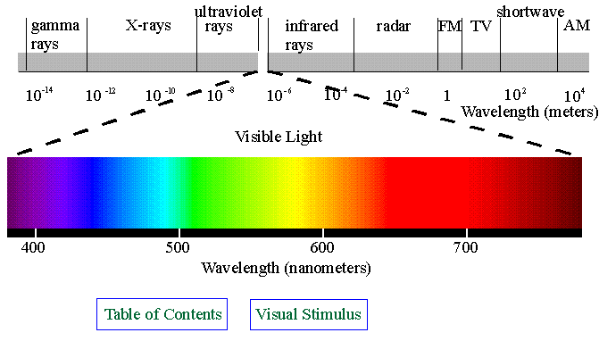
C. Functions of the eye 1. brief lesson in optics
a. Electromagnetic spectrum

Slide 10
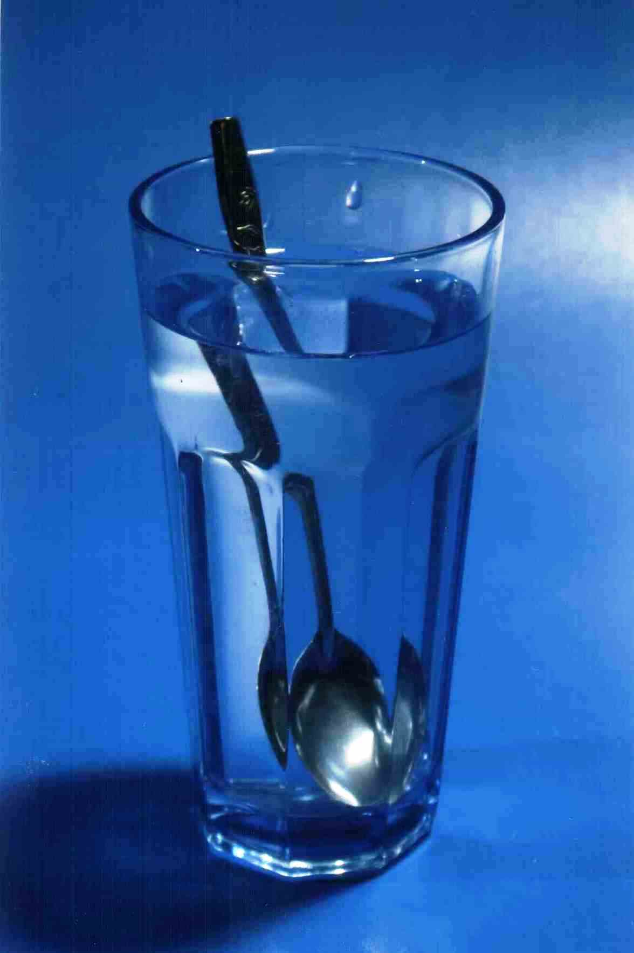
b. When light hits an object
Reflected
Absorbed
Refracted

Slide 11
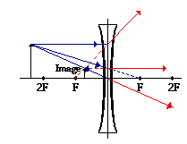
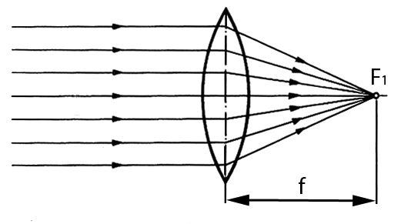
c. Lenses and refraction
Biconvex lens-convergence
Biconcave lens-divergence

Slide 12
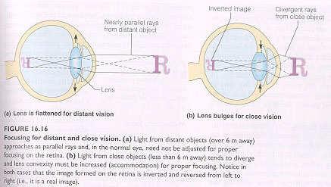
2. Normal focusing system of eye-distance vision
a. Ancestors were hunters
b. Evolved where distance vision most important
c. Lens is flattened with minimum need to refract
d. Emmetropia and distance is about 20 feet

Slide 13
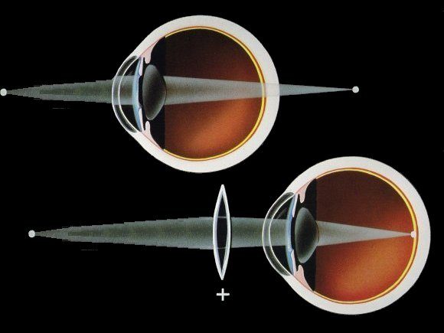
3. Accomodation
a. Objects closer light rays are divergent
b. More refractive power is needed
c. Lens must get thicker
d. Ciliary body contracts taking stress off suspensory ligaments
e. Lens passively thickens
f. Eye strain
g. Near point of accomodation- children few inches
g. presbyopia

Slide 14
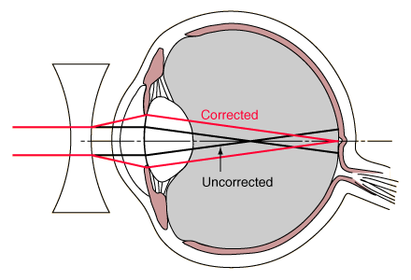
4. myopia-near sightedness
a. Focal point too short
b. Eyeball is too long
c. Can see close up
d. Distance vision needs biconcave lenses

Slide 15
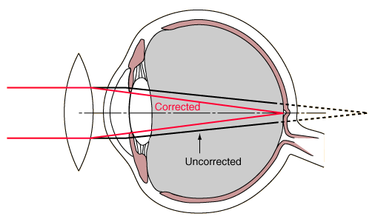
5. hyperopia-farsightedness
a.
b.
c.

Slide 16
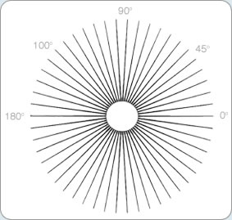
6. Astigmatism
a. Cornea is not symmetrical
b. Thicker in some spots and thinner in others
c. Unequal refraction
d. Some parts of this chart are in focus while others aren’t

Slide 17
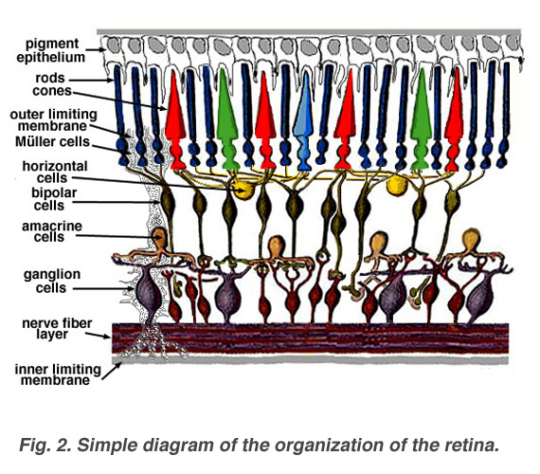
D. Retinal characteristics
1. Rod cells
a. Most numerous
b. Respond to dim light
c. Located in the periphery of the retina
d. Exhibits convergence in the retina allowing for spatial summation
e. Photosensitive pigment is derived from Vitamin A

Slide 18
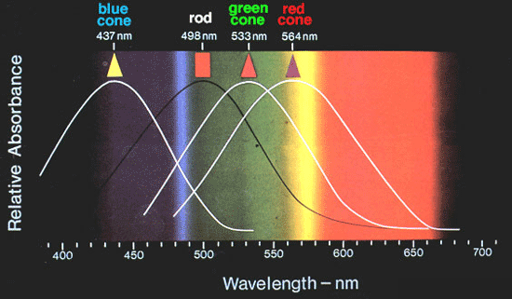
2. Cone cells
a. Responsible for color vision
b. Three different varieties
c. Respond to blue, green, red
d. Do not show convergence-usually one red to each bipolar cell
e. Concentrated in the fovea centralis of the macula lutea
f. Major point of focus for the optic system
g. Different colors of the spectrum stimulate the different photoreceptors proportionately-like mixing paint at the paint store

Slide 19
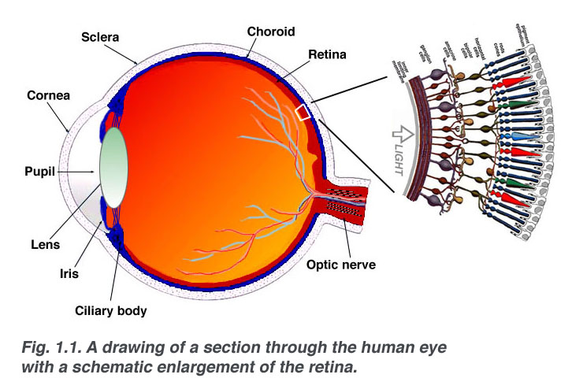
3. Retinal design
a. Location of photoreceptors at the back of the retina
b. Bipolar layer comes next
c. Then ganglionic layer
d. Efferent axons travel along surface of retina, converge at the optic disc, and exit the eyeball at the blind spot

Slide 20
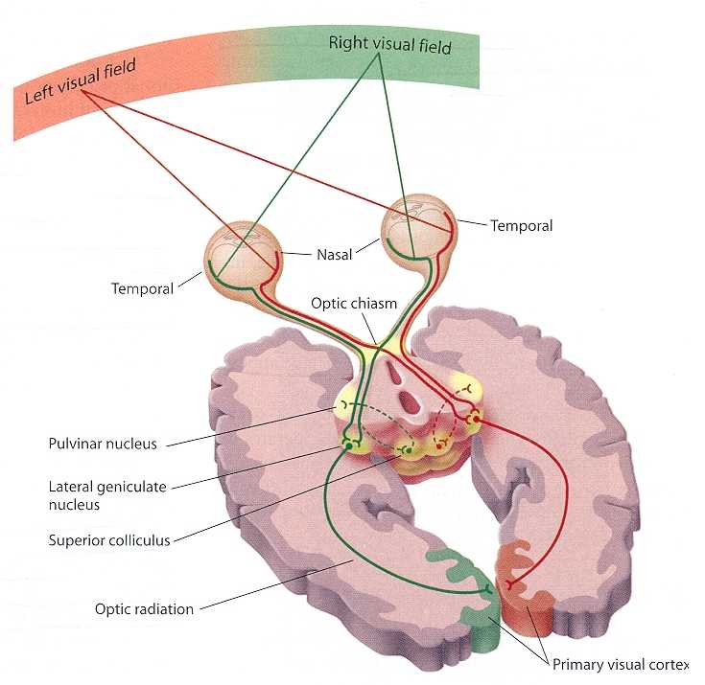
4. Visual pathways
a. Optic nerve
b. Optic chiasma
c. Optic tract
d. Passes to thalamus
e. Synapse with fibers to occipital lobe
f. Interneurons to superior colliculi of the midbrain

Slide 21
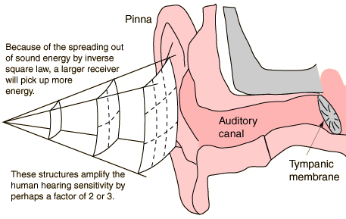
II. Ear A. Structures of outer, middle, and inner ear
1. Outer ear
a. Also called pinna
b. Collects vibrations
c. Funnels energy onto tympanic membrane
d. Auditory canal
e. Ceruminous glands-modified sebum
f. Tympanic membrane

Slide 22
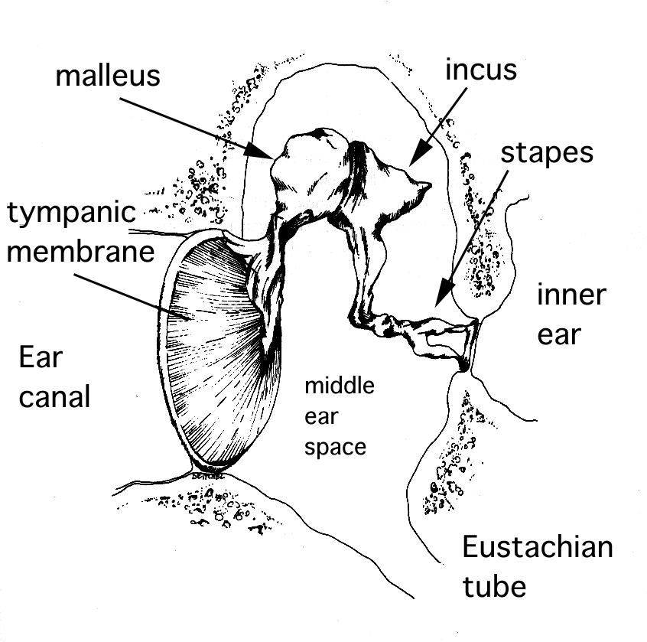
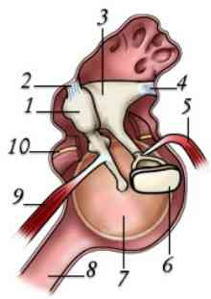
2. Middle ear
a. Malleus
b. Incus
c. Stapes
d. Oval window
e. Round window
f. Tensor tympani
g. Stapedius

Slide 23
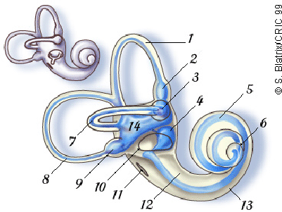
3. Inner ear
a. Vestibule with oval window
b. Semicircular canals-organ of balance and sensation of movement
c. Cochlea-organ of hearing

Slide 24
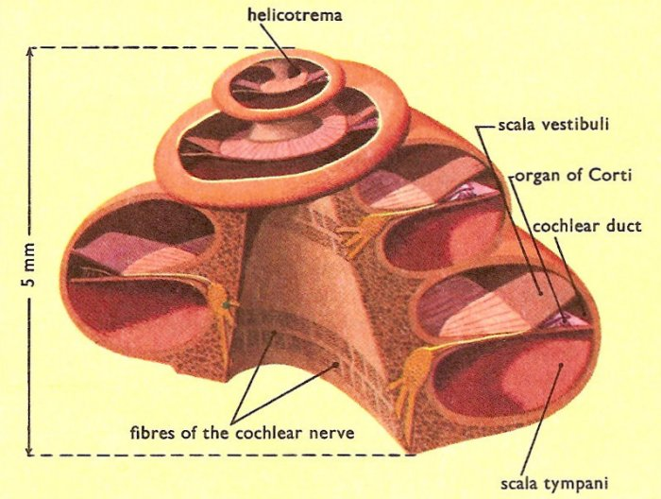
4. Cochlear structure
a. Three ducts running parallel through the coils of the snail
b. Tip of shell called helicotrema
c. Scala vestibuli starts at the oval window
d. Scala tympani starts at the helicotrema
e. Cochlear duct is sandwiched in between

Slide 25
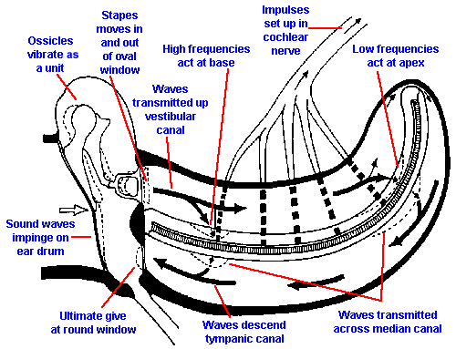
B. Physiology of hearing-Think of cochlea as a party favor unrolled
1. sounds strike tympanic membrane
2. stapes plunges into and out of oval window which communicates with scala vestibuli
3. wave transmitted into fluid of scala and travels toward helicotrema
4. dependent upon frequency, sound wave produces harmonic resonance
5. high frequency nearer to the oval window
6. pressure relief at the round window

Slide 26
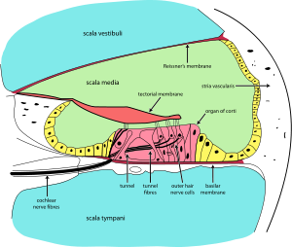
C. Organ of Corti
1. sensory structure that converts wave energy into nervous impulses
2. organ of corti is to the ear as the ______ is to the eye
3. when wave crosses from scala vestibuli to scala tympani, passes through the scala media
4. pressure wave causes tectorial membrane to wave in the wind
5. hair cells are deformed
6. action potentials are produced

Slide 27
D. Balance and the inner ear
1. two types of balance-static vs dynamic
2. the detection of static equilibrium is a detection of position relative to gravity
3. the vestibule of the ear houses the sensory structure detecting static equilibrium
4. the detection of dynamic equilibrium is the sensation of movement or acceleration and deceleration
5. dynamic equilibrium is detected in the semicircular canals

Slide 28
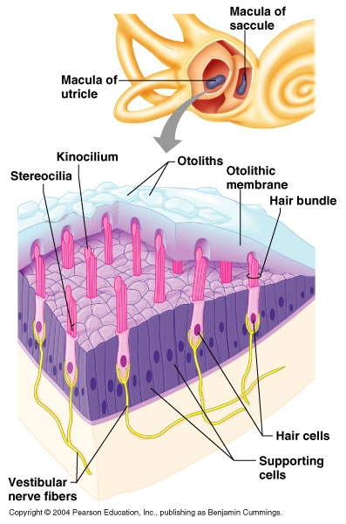
6. Static equilibrium
a. Utricle and saccule
b. Macula of utricle is parallel
c. Macula of saccule is perpendicular
d. Tips of hair cells are displaced as otoliths repsond to the pull of gravity
e. Bending of the hair cells produces an action potential

Slide 29
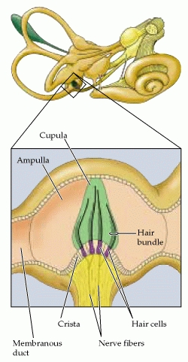
7. Dynamic equilibrium
a. Three canals oriented at right angles to eachother
b. Filled with fluid
c. Sensory structure is called crista ampullaris that is located in the swollen ampulla of each canal
d. Rotational movement of head produces a flow of endolymph across the cupula of the crista
e. Displaces hair bundles and produces the feeling of rotation
f. Bat at tip of forehead

Slide 30
