Slide 1
The Respiratory System

Slide 2
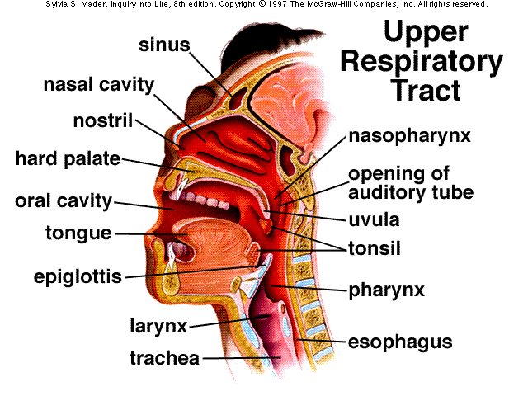
I. The Functional Anatomy of the Respiratory System
Nose
Nares
Nasal cavity
Respiratory mucosa
Nasal conchae
Hard palate
Soft palate
Paranasal sinuses

Slide 3
B. Pharynx-throat
Common passageway
Three portions
Auditory tube
Tonsils
a. pharyngeal (ad)
b. palatine
c. lingual

Slide 4
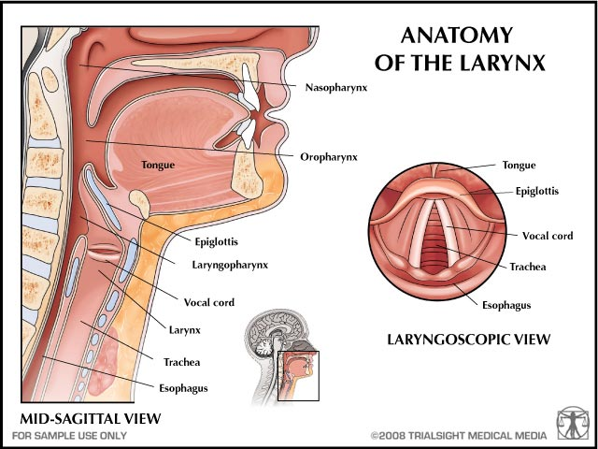
C. Larynx (voicebox)
Epiglottis
Thyroid cartilage
Vocal folds
Glottis
utube http://www.youtube.com/watch?v=ajbcJiYhFKY

Slide 5
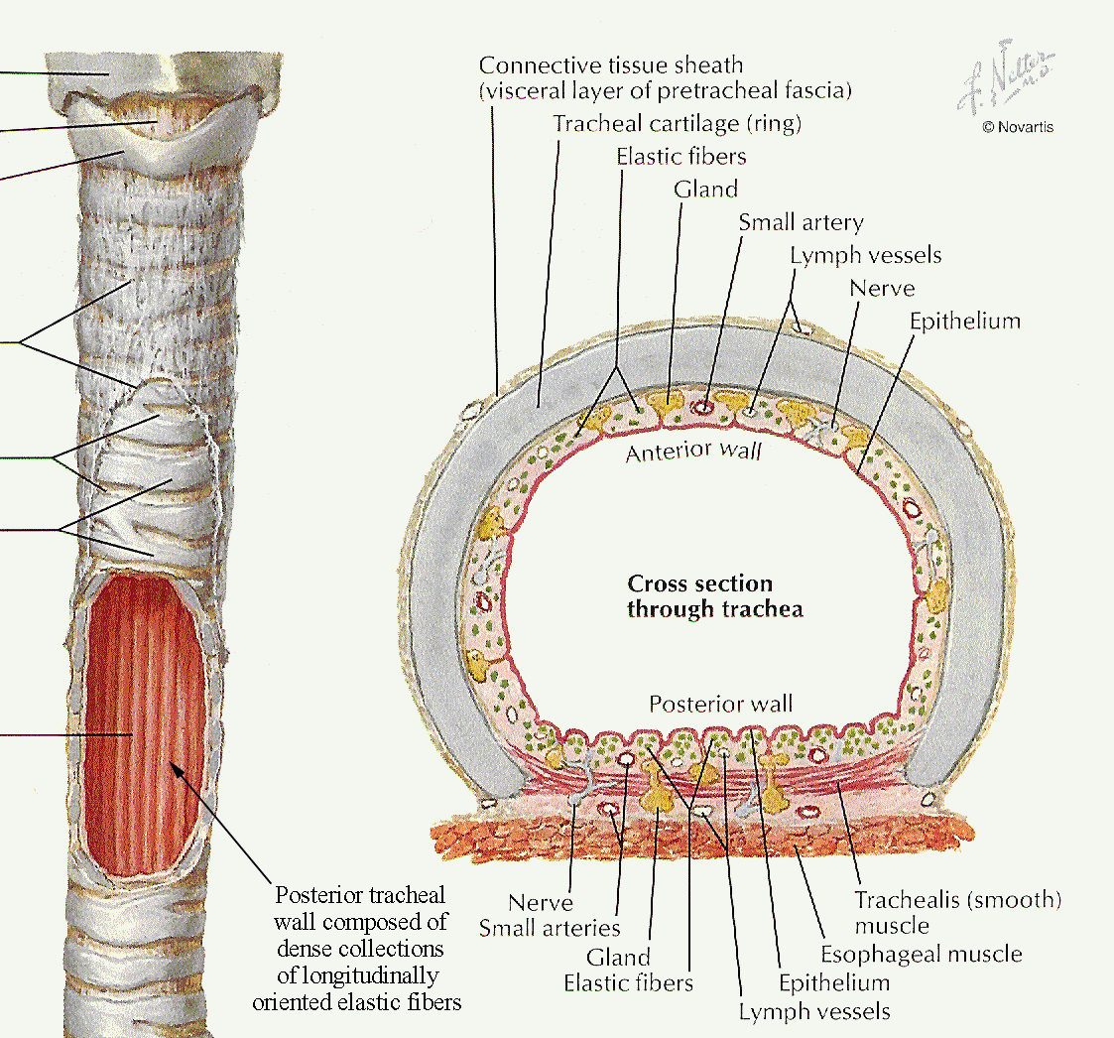
D. Trachea and bronchi
1. trachea C shaped ring
2. windpipe
3. ventral to esophagus
4. bronchi branch at carina
5. right bronchus wider shorter and straighter
6. Heimlich maneuver-http://www.youtube.com/watch?v=tEIiEAn7b-U&feature=player_detailpage

Slide 6
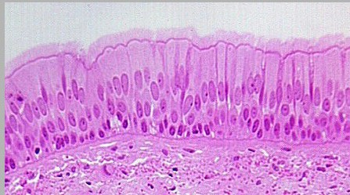
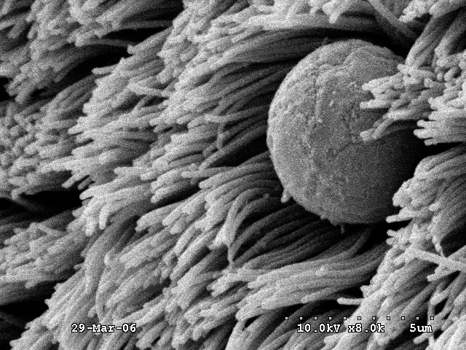
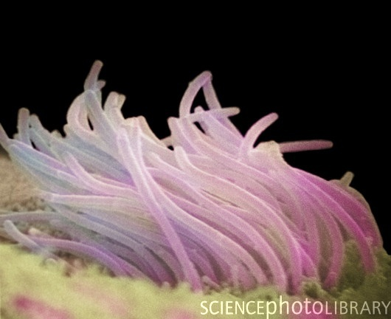
Slides of respiratory mucosa

Slide 7
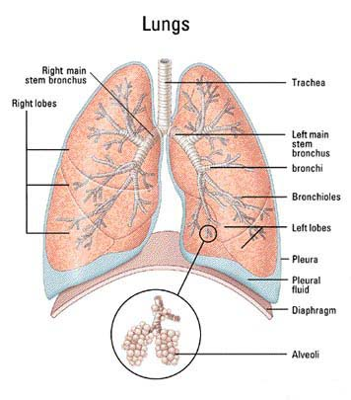
E. Lungs
Apex and base
Pleural membranes
Pleural fluid
Pleurisy
Right lung three lobes
Left lung two lobes
Respiratory tree

Slide 8
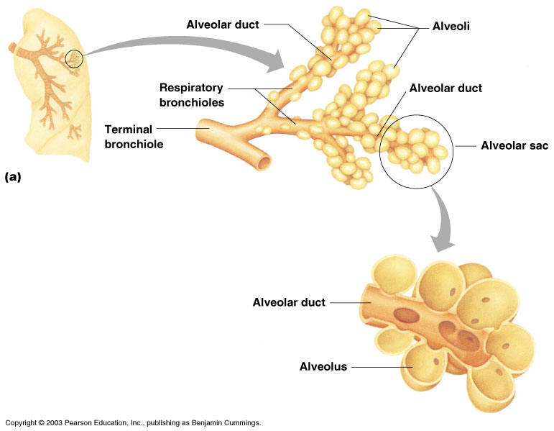
F. Respiratory zone
1. zone where gas exchange occurs
2. respiratory bronchioles
3. alveolar ducts
4. alveolar sacs

Slide 9
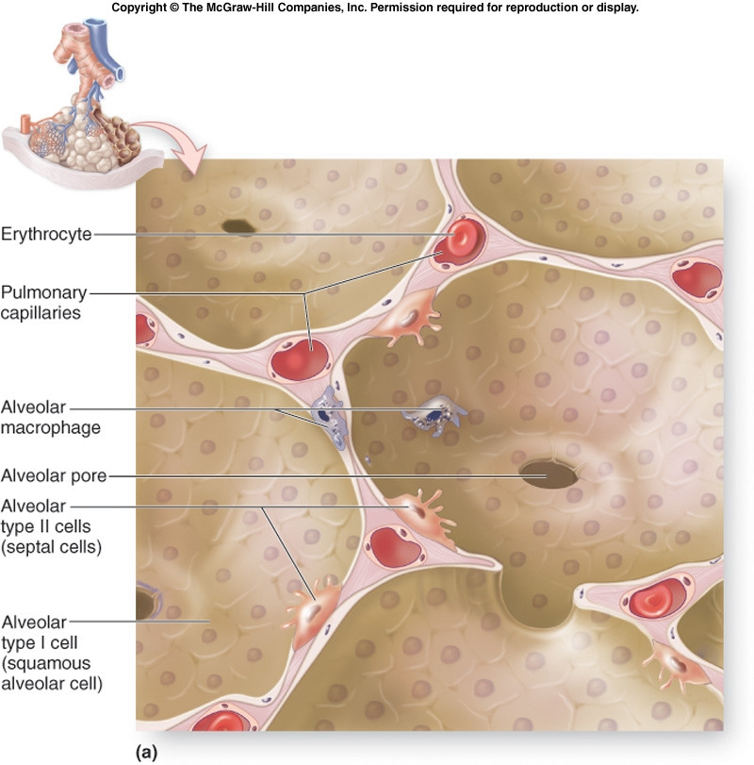
G. Alveoli
Simple squamous
Pulmonary caps
Thinner sheet tissue paper
Alveolar pores
Simple diffusion
50-70 meters squared (40 X skin)
Alveolar macrophages
Type II cells-pulmonary surfactant

Slide 10
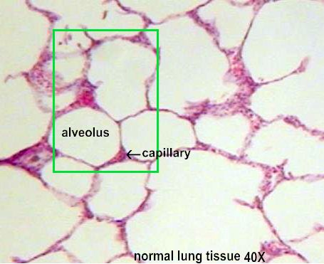
Alveolar Tissue

Slide 11
II. Respiratory physiology
A. Volume vs. pressure
1. gases conform to the shape of their container
2. in a large volume, the molecules of the gas are spread out
3. few collisions between the molecules and walls
4. larger volume lower pressure
5. volume decreases
6. more frequent collisions
7. higher pressures
8. gases flow (like water) from areas of higher to lower pressures

Slide 12
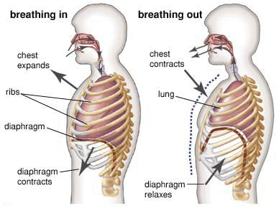
B. Events of inspiration-active process
Surface tension between pleural membranes
Diaphragm contracts
External intercostals contract
Voume increases
Pressures drop
Air pressure higher than pulmonary pressures
Air flows into lung

Slide 13
C. Exhalation or expiration
Passive process
Elastic recoil
Ribs return
Diaphragm relaxes
Lung volume drops
Air compressed
Expiration should be effortless
Asthma or chronic bronchitis
Forced expiration

Slide 14
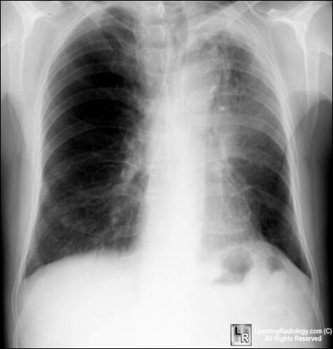
D. Intrapleural pressure
Healthy lung intrapleural pressure is always negative
Prevents lung collapse
Air enters pulmonay space
Pneumothorax
Atelectasis

Slide 15
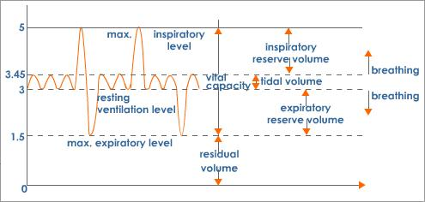
E. Respiratory volumes
Tidal volume-500
IRV-3000ml
ERV-1200ml
Residual volume-1500 ml
Vital capacity= TV + IRV + ERV
Dead space volume = 150 ml

Slide 16
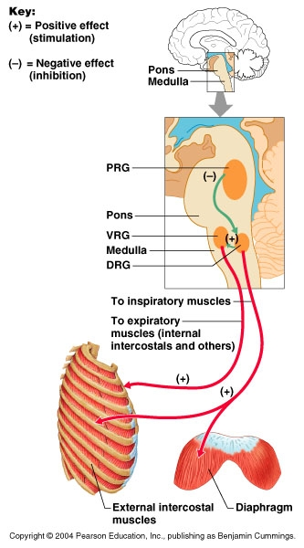
III. Control of respiration
A. Breathing control centers
1. brain stem-pons and medulla
2. VRG-self-exciting inspiratory center
3. phrenic and intercostal nerves
4. normal breathing eupnea

Slide 17
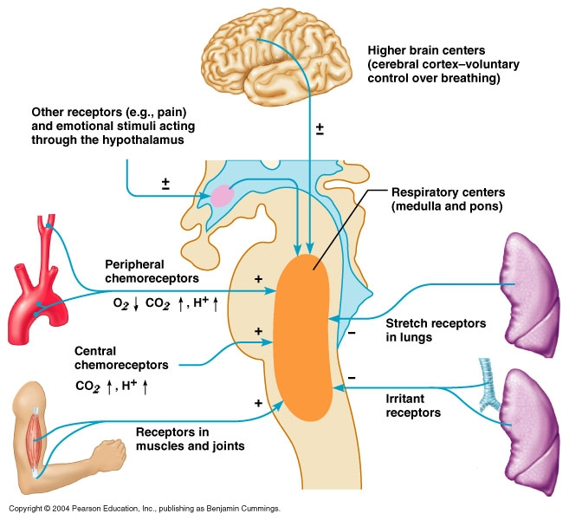
B. Modifiers of respiratory effort
Higher brain centers
Stretch receptors
Receptors in muscles
Peripheral chemoreceptors

Slide 18
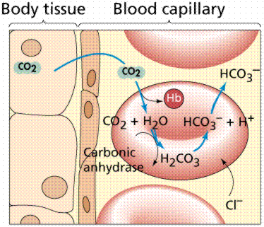
C. Chemical factors
Chemoreceptors monitor blood chemistry
Main stimulus is carbon dioxide and pH
Carbon dioxide transport
Main stimulant for respiratory efforts
Also tied to pH
Oxygen concentrations are of secondary importance

Slide 19
D. Interesting case of emphysema
COPD
Inspiration easier than expiration
Lungs retain some of each breath
Residual volume increases
Diaphragm flattens
Carbon dioxide is retained
Oxygen levels become main stimulant for respiratory effort
Oxygen must be administered at low levels
If administered at high levels as might be indicated, patient would stop breathing because the respiratory stimulus would be gone (low oxygen levels).

Slide 20
E. Hyperventilation
Young nervous women
Increased depth of breathing-what happens to carbon dioxide levels
What happens to pH
Cerebral vessels constrict
May get dizzy and faint
Breathing into paper bag

