Slide 1
The Urinary System

Slide 2
I. Functions
A. Maintain and purify internal medium
B. Filter body fluids eliminating excess electrolytes and wastes C. Return needed materials to circulatory system
D. Regulate blood volume and chemical make-up
E. Renin-helps to regulate blood pressure
F. Erythropoietin-red blood cell production

Slide 3
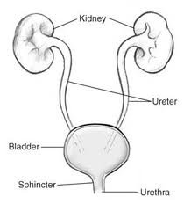
II. Organs of urinary system
A. Kidneys
B. Ureters
C. Bladder
D. Urethra

Slide 4
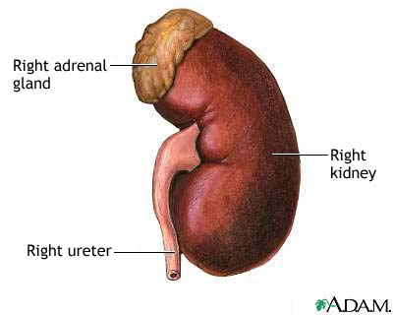
III. Kidney Details
A. Retroperitoneal superior lumbar position
B. Size
1. five inches long
2. three inches wide
3. one inch thick
C. External features
1. hilum
2. adrenal gland
3. fibrous capsule
4. perirenal fat capsule
5. renal fascia anchors to muscles of trunk wall

Slide 5
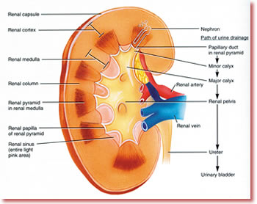
D. Internal anatomy
1. renal cortex
2. renal medulla
3. renal pyramids
4. renal columns
5. renal pelvis
6. calyces

Slide 6
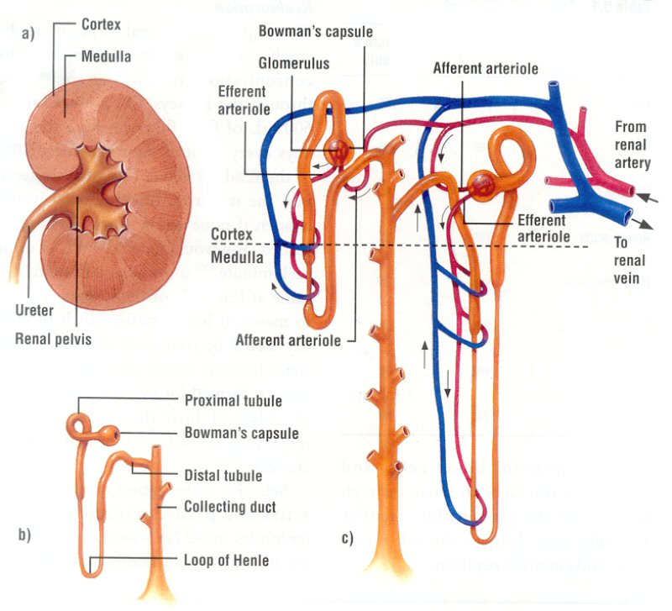
E. Nephron structure
1. Functional unit
Bowman ‘s capsule-podocytes or filtration slits
Proximal convoluted tubule
Loop of henle
Distal convoluted tubule
Collecting duct
Cortical vs. juxtamedullary nephrons

Slide 7
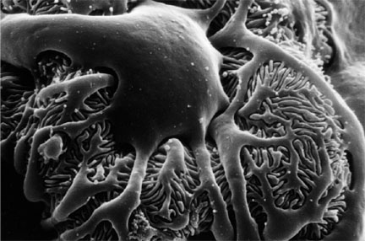
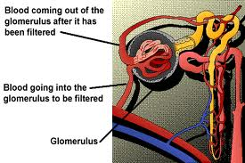
F. Circulatory supply to nephron
Afferent arteriole
Glomerulus
Efferent arteriole
Peritubular capillary bed
Diameters of two vessels

Slide 8
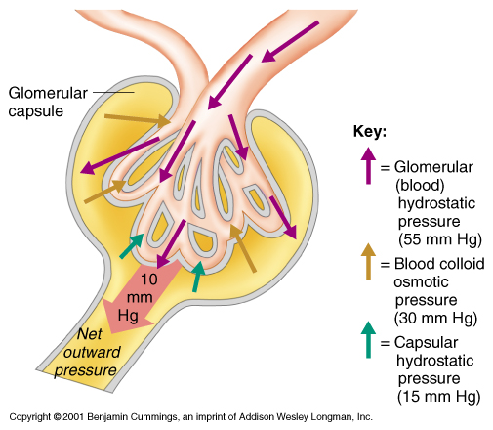
III. Urine formation
A. Filtration
1. nonselective
2. passive process
3. everything but RBC and large proteins
4. essentially plasma without proteins
5. huge amounts formed-150 liters of filtrate

Slide 9
B. Tubular reabsorption
Useful as well as wastes
Begins in prox conv tubule
Cells transport
Glucose, amino acids, electrolytes
Not reabsorbed-urea, uric acid, creatine
Absorbed into peritubular capillary beds
http://www.youtube.com/watch?v=glu0dzK4dbU

Slide 10
C. Secretion
Moving materials from the distal convoluted tubule to the efferent arteriole
H and K ions and creatinine
Certain drugs
Moving materials to help control pH

Slide 11
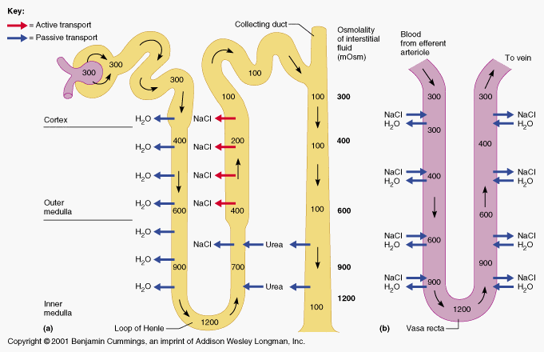
D. Creation of a concentrated urine
Remember that water follows salt
Loop of henle
Ascending limb actively pumps salt out and is impermeable to water
Descending limb permeable to water but not salt
Salt gradient is formed
Collecting ducts are variably permeable depending on presence of ADH

Slide 12
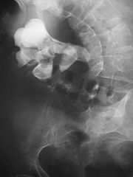
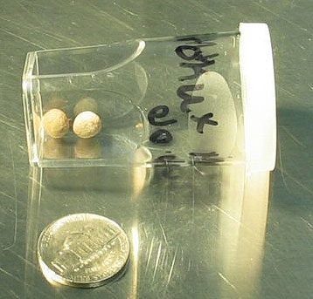
IV. Other organs of system
Ureters
Approximately 10-12 inches
Travel from hilum to posterior aspect of bladder
Peristaltic movement of urine
Continuous with renal pelvis
Renal calculi
lithotripsy

Slide 13
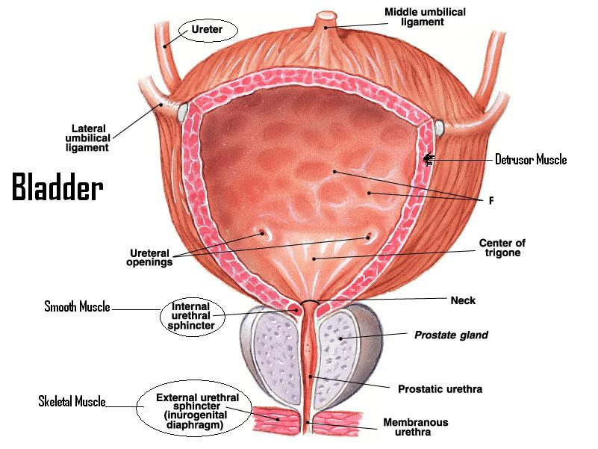
B. Bladder
Three openings
Trigone-infections persist here
Prostate
Transitional epith
May hold two pints of urine
Urethritis
Cystitis

