Slide 1
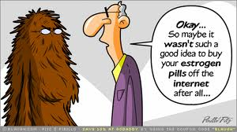
Reproductive Biology

Slide 2
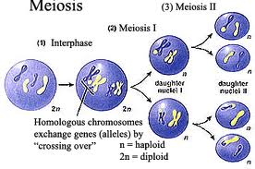
I. Need for Meiosis
A. Human chromosome number = 46
B. Mitosis
C. Meiosis
1. purpose
2. location
3. difference in male and female meiosis

Slide 3
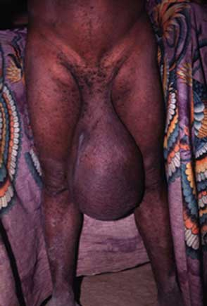
II. Male parts
A. Scrotum-an air conditioner
1. homologous to the female labia majora
2. sac surrounded covered by skin and layer of smooth muscle called the dartos muscle
3. cremaster muscles (extension of abdominal muscle) are also attached to the scrotum
4. ideal temperature for sperm production is 95 degrees
5. dependent upon temperatures these two muscles either contract or relax pulling testes closer to the body

Slide 4
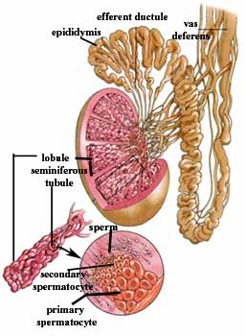
B. Testes
1. produces sperm in seminiferous tubule
2. approximately 700 feet long
3. site of male meiosis
4. interstitial cells also located in testes
5. producers of testosterone

Slide 5
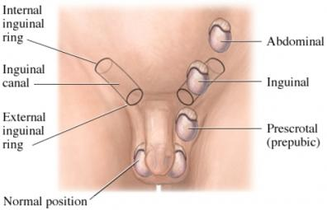
6. Descent of the testicles
a. Testes develop in the abdomen
b. Connected by a muscle called the gubernaculum to developing scrotum
c. The gubernaculum extends from the developing scrotum to the testes through the inguinal canal
d. Around 7-9 months of development, the gubernaculum pulls the testes down through the inguinal canal into the scrotum
e. cryptorchidism

Slide 6
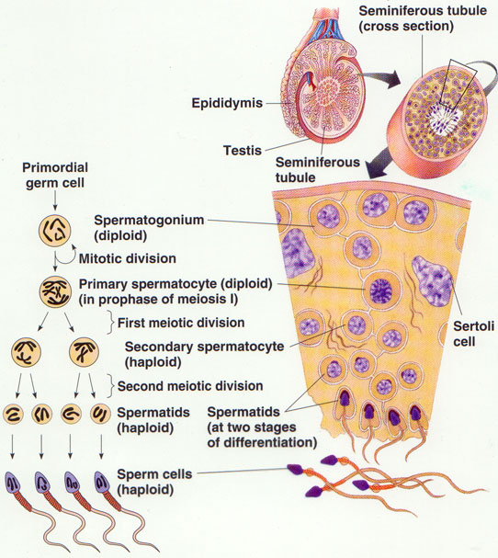
7. Spermatogenesis
a. Spermatogonia
b. Primary spermatocytes
c. Secondary spermatocytes
d. Spermatids
e. Spermiogenesis
f. Sperm cell
g. Sustentaculuar cell or Sertoli cell (nurse cell)
h. Blood-testis barrier

Slide 7
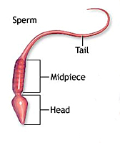
8. Sperm cell
a. Head
b. Acrosome
c. Midpiece
d. Tail
e. http://www.youtube.com/watch?v=7kM_kRPrcrk

Slide 8
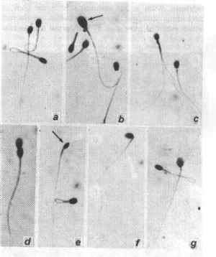
9. Defective sperm and numbers
Defective morphology
Low sperm count
10 million/ml
Varicocoel
Cryptochordism
Retrograde ejaculation

Slide 9
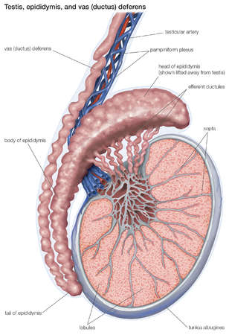
C. Epididymis
1. location
2. Head, body, tail
2. 20 feet
3. twenty days to pass through
4. undergo maturation
5. storage organ
6. contracts upon ejaculation sending sperm on to next part of journey

Slide 10
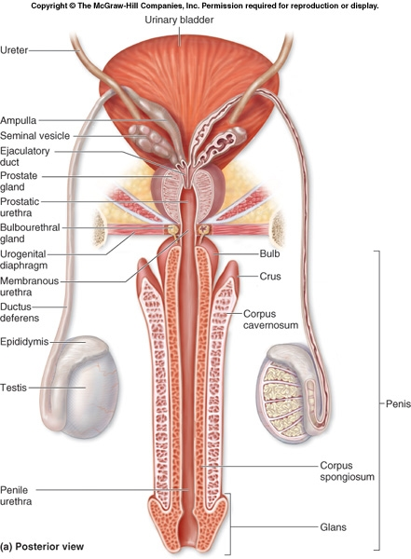
D. Vas deferens or ductus deferens
Travels from epididymis to urethra
Travels through the inguinal canal with the spermatic cord-blood vessels and nerves
Expands into the ampulla
Then enters ejaculatory duct
Pseudostratified epithelium
Peristaltic contractions move sperm along

Slide 11
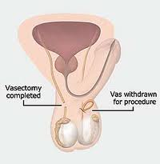
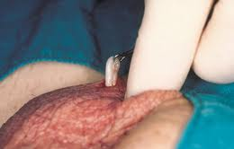
7. Vasectomy
Part of vas lies in scrotum
Local
Small incision
Cuts and ligates
Sterile but not impotent

Slide 12
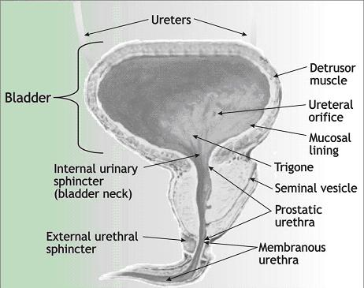
E. Urethra
Prostatic urethra
Membranous urethra
Spongy or penile urethra
Carries both sperm and urine
Never at same time
Stratified columnar most of length
Transitional at bladder end and stratified squamous at penile opening

Slide 13
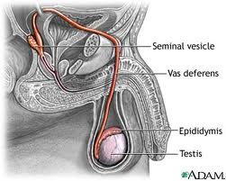
F. Accessory glands producing semen
1. seminal vesicles
a. Produce 60% of semen
b. Thick yellowish secretion
c. Rich in sugar, vitamin C, prostaglandins, and fibrinogen
d. Nourish and activate sperm
e. Joins vas deferens on either side to form ejaculatory duct

Slide 14
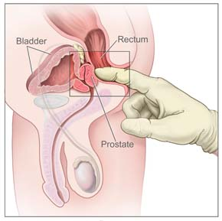
2. Prostate gland
Doughnut shaped
Size of peach pit
Milky alkaline fluid that activates sperm
Approximately 30% of semen
Anterior to rectum is able to be palpated by digital exam
Fibrinolysin
Hypertrophy

Slide 15
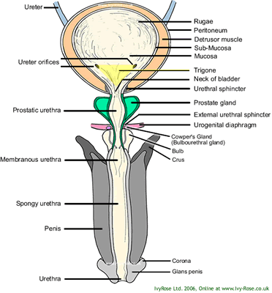
3. Bulbourethral glands
Also called Cowper’s glands
Base of prostate-size of peas
First to empty with ejaculation
Cleanse and neutralizes penile urethra
Also minor lubricant for coitus

Slide 16
4. Seminal fluid
Mature sperm are streamlined missiles
Need nutrient source-fructose from seminal vesicle
Need buffer from prostate
Prostaglandins cause smooth muscle to contract
Fibrinogen and profibrinolysin
Inhibitors of female immune system
Dilutes sperm

Slide 17
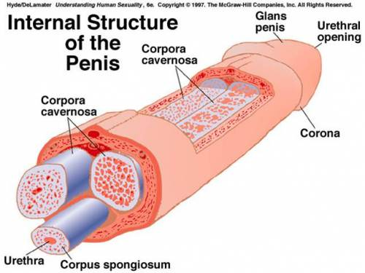
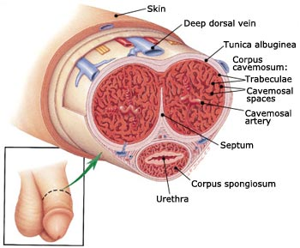
G. Penis
Corpora cavernosa
Corpus spongiosum
Urethra
Glans penis
Prepuce
Circumcision
Mechanics of an erection

Slide 18
III. Male hormone regulation
A. Gonadotropin releasing hormone
1. hypothalamus
2. controls release of hormones from anterior pituitary.
Anterior pituitary hormones (sounds like female hormones)
1. FSH -binds to sustentaculuar cells
2. LH (ICSH)-binds to interstitial cells

Slide 19
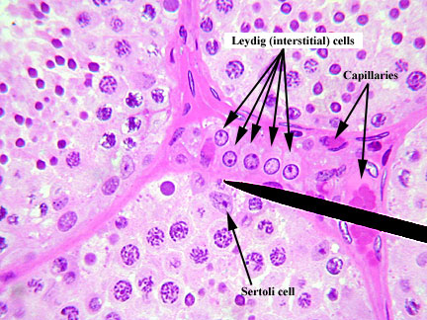
C. Testosterone production
Interstitial cells of Leydig
In response to LH production by the anterior pituitary
Occurs at about the age of 12
Maturation of male reproductive parts
Stimulates production of sperm along with FSH
Produces male secondary sexual traits such as hair growth patterns, deepening of the voice, skeletal muscle development, increase in metabolic rate
Targets cells with testosterone receptors
Some brain cells convert testosterone to estrogen governing some male sexual behaviors

Slide 20
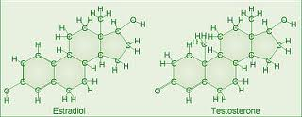
Testosterone and Progesterone

Slide 21
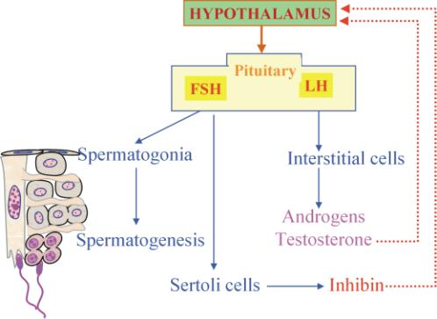
D. Inhibin
1. produced by sustentacular cells
2. inhibits hormones produced by FSH production
3. possible pharmaceutical functions

Slide 22
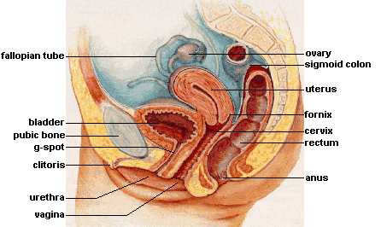
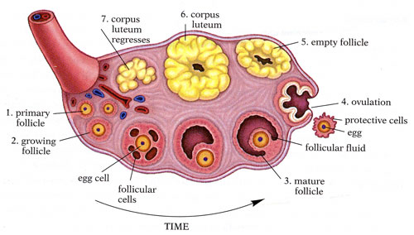
IV. Female parts
Ovary
1. primary follicle-huge number-arrested at prophase I
2. ovarian follicles
3. oocyte and follicular cells
4. antrum with follicular fluid
5. Graafian follicle
6. ovulation-secondary oocyte arrested at metaphase II
7. corpus luteum
8. corpus albicans

Slide 23
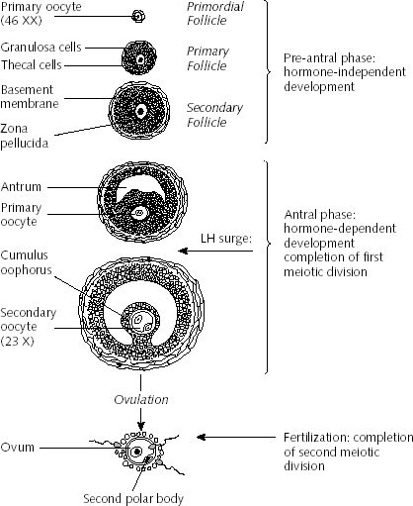
Follicle development

Slide 24
Ovulation
http://www.youtube.com/watch?v=nLmg4wSHdxQ
Ovarian slide
http://medsci.indiana.edu/a215/virtualscope/docs/chap11_3.htm

Slide 25
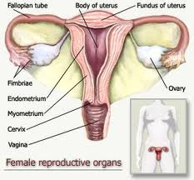
B. Duct system
Fallopian tubes
Fimbriae
Uterus
a. Body, fundus, cervix
b. Endometrium, myometrium
c. http://medsci.indiana.edu/a215/virtualscope/docs/chap11_4.htm
Vagina-birth canal

Slide 26
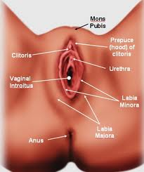
C. Female external genitalia
Mons pubis
Labia majora
Labia minora
Vestibule
Clitoris
Perineum

Slide 27
V. Female physiology
A. Hormones involved
1. Pituitary
a . FSH
b. LH
2. Ovarian hormones
a. Estrogen-proliferation of endometrium, increases sensitivity of myometrium to stimuli, increases production of progesterone receptors
b. Progesterone- endometrial hypertrophy, relaxes myometrium

Slide 28
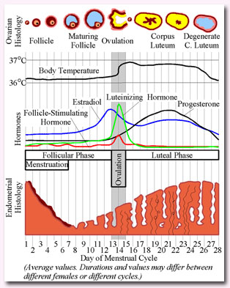
B. Timing of typical 28 day cycle
1. menses phase (days 1-4)
2. proliferative phase or follicular phase (days 5-14)-most variable
3. ovulation (day 15)
3. luteal phase or secretory phase (days 15-28)-typically lasts 14 days

Slide 29
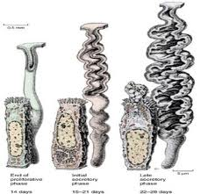
C. Endometrial changes
Proliferative phase
a. Epithelial cells proliferate
b. Form tubular spiral glands
Secretory phase
a. Epithelial cells hypertrophy
b. Glands become more spiraled and thicker
3. Day 21 is optimum for implantation

Slide 30
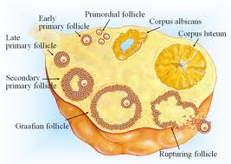
D. Ovarian events in review

Slide 31
Isolated forgotten terms
Menarche
hCG
Capacitation
Amenorrhea
Ectopic pregnancy
Menopause
Climacteric-perimenopause

Slide 32
And then there was baby
http://www.evtv1.com/player.aspx?itemnum=735

Slide 33
Fetal development
http://www.youtube.com/watch?v=RS1ti23SUSw

